Slide 2
Best Practices in EMS
Beyond the Basics

Slide 3
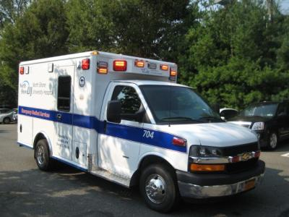
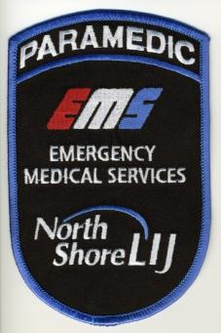
About Us…
Located in NYC / Long Island Region
Highly competitive marketplace
500+ Employees and growing
100+ Vehicles and growing
100,000+ Annual call volume and growing
$40M+ Annual budget

Slide 4
About Us…
9-1-1 Programs (FDNY & Municipal)
Inter-facility / CCT-SCT / Private Emergency
Training / Command & Control / Billing / PI
Multiple deployment centers throughout region
Margin contributor (minus FDNY 911)
Defining a new category of EMS system design
“Healthcare System” Based EMS Agency
On the bleeding edge of defining “Systems” based care
Coordinated network management of patients
Have a seat at the table (untraditional)

Slide 5
About Us…
Our “Cradle to Grave” Healthcare System
5 Tertiary Hospitals
11 Community Hospitals
1000’s Doctors / Clinics
Nursing Homes / Rehabs / Home Care / Hospice
Internal and External Pharmacies
45,000+ Employees
Revenues of $6B+
2nd Largest Not for Profit Secular Health System in the United States
Partially Integrated working towards complete integration

Slide 6
Best Practices in EMS Beyond the Basics
What is a Best Practice (BP)
Why does EMS need BP’s
Importance of NEMSAC Finance Sub-committee Recommendations
Logistics & Safety BP’s
Emerging BP’s from last year’s session now today’s reality
Emerging & future BP predictions
EMS Technology & Innovation
Worst practices in EMS

Slide 7
What is a Best Practice
A Best Practice is the belief that there is a technique, method, process, activity, incentive or reward that is more effective at delivering a particular outcome than any other technique, method, process, etc. The idea is that with proper processes, checks, and testing, a desired outcome can be delivered with fewer problems and unforeseen complications. Best practices can also be defined as the most efficient (least amount of effort) and effective (best results) way of accomplishing a task, based on repeatable procedures that have proven themselves over time for large numbers of people.

Slide 8
Why Does EMS Need Best Practices?
Service delivery model variations / inconsistencies
Lack of commonly accepted operational standards (like NFPA for Fire Service)
Mix of public / private / government ownership
Mix of for profit / non-profit models
No single lead federal agency

Slide 9
Why Does EMS Need Best Practices?
Lack of standardized advanced managerial education platform
Industry has attempted to bridge educational gap with limited success
Success lies in sharing some clinical & billing best practices but not operational ones

Slide 10
Why Does EMS Need Best Practices
“As EMS providers, we invite the public to literally trust us with their lives. We advise the public that, during a medical emergency, they should rely upon our organization, and not any other. We even suggest that it is safer to count on us, than the resources of one’s own family and friends. We had better be right.
Regardless of actual performance, EMS organizations do not differ significantly in their claimed goals and values. Public and private, nearly all claim dedication to patient care. Efficient or not, most claim an intent to give the community its money’s worth. And whether the money comes from user fees or local tax sources, the claim is the same—the best patient care for the dollars available. It’s almost never true.
Our moral obligation to pursue clinical and response time improvement is widely accepted. But our related obligation to pursue economic efficiency is poorly understood. Many believe these are separate issues. They are not. Economic efficiency is nothing more than the ability to convert dollars into service. If we could do better with the dollars we have available, but we don’t, the responsibility must be ours. In EMS, that responsibility is enormous—it is impossible to waste dollars without also wasting lives.”
Jack L. Stout

Slide 11
BP’s are part of the “EMS Success Triad”
Balancing of
Patient Care
Clinical sophistication
Customer service
Systems integration
Employee Well-being
Compensation & benefits
Health / safety / welfare
Financial Sustainability
Properly designed service delivery systems
Revenue maximization
Sound business management

Slide 12
Importance of NEMSAC Finance Sub-committee Report
Advisory on Performance Based Reimbursement
http://www.ems.gov/NEMSAC-recommendations.htm

Slide 13
NEMSAC Finance Committee
Troy Hagen
Brenda Staffan
Cathy Gotschall
James McPartlon
Jim Finger
Kurt Krumperman
Marc Golstone
Vince Robbins
Gary Wingrove
Shirley Ernst
Jonathan Washko

Slide 14
Importance of NEMSAC Finance Committee Report
2011 – 2012 committee of various stakeholders & groups
Charged with providing recommendations on the future of system EMS financing
11 Conclusions & 2 Recommendations
Two additional important outcomes
Stratification of EMS functions by discipline
List of comprehensive EMS system functions and recommended payer sources
Will help shape and drive existing and new BP’s

Slide 15
NEMSAC Conclusions
The systematic cost of providing emergency ambulance services in the US exceeds currently available revenue
A comprehensive evaluation of total EMS System cost must not be limited to ambulance transport, but include each of the individual system functions and activities
[Summarizing] EMS’s underfunding crisis is a result from misperception of the role of EMS agencies in the broader healthcare system by the government and the public
EMS functions are a combination of government requirements and services driven by user demands and payer requirements

Slide 16
NEMSAC Conclusions
EMS Systems exist concurrently within the realm of health care, public health, public safety and emergency medical preparedness systems, yet reimbursement by user fees (health care) is often the only reliable source of funding.
The public expects the around the clock availability of high quality EMS response.
Emergency services must be ready to respond 24/7.
EMS must be fully and effectively integrated into the broader health care system to fully realize improved patient outcomes, efficiencies and patient satisfaction.

Slide 17
NEMSAC Conclusions
As the community healthcare safety net, EMS responds to emergency requests regardless of the patient’s ability to pay
New service delivery paradigms, including community paramedicine, advanced practice paramedics, continuum of care coordination by medical communications (9-1-1) and other components of preventative care provided by ambulance agencies have shown promising early results.
The federal government should support and endorse efforts in local, state and federal policy arenas to assure the financial stability and improved performance of all of the functions of the EMS system.

Slide 18
NEMSAC Recommendations
Recommendation 1: NHTSA, in coordination with FICEMS, should sponsor a comprehensive EMS System Design project that will identify the essential components and functions of EMS systems, standardize terminology, and establish performance standards for minimum levels of service.
Recommendation 2: NHTSA, in coordination with FICEMS, should sponsor a comprehensive EMS System finance study that accounts for all costs and revenues

Slide 19
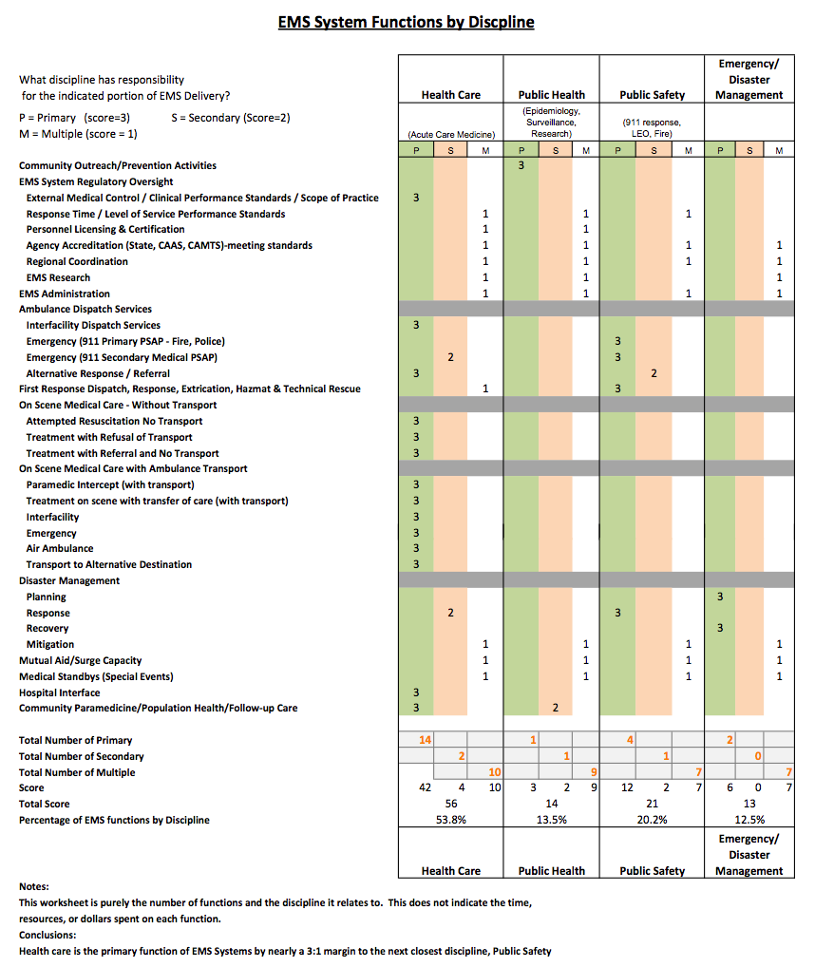

Slide 20
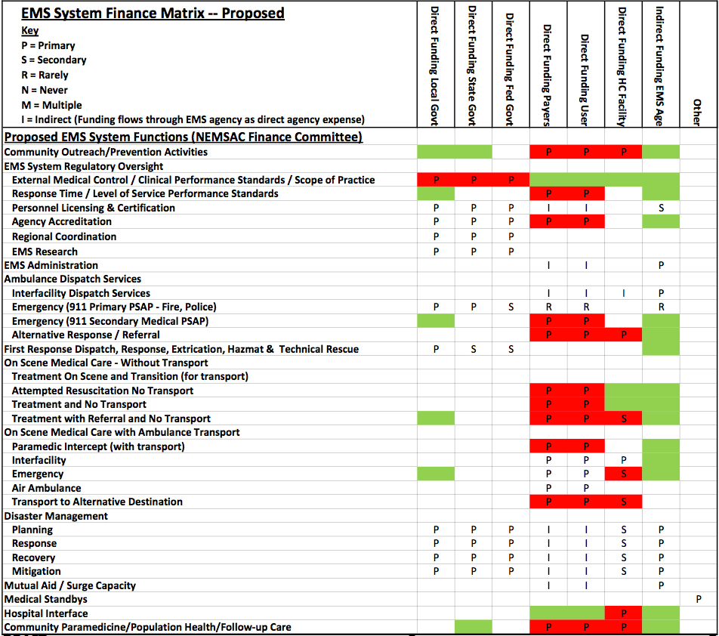

Slide 21
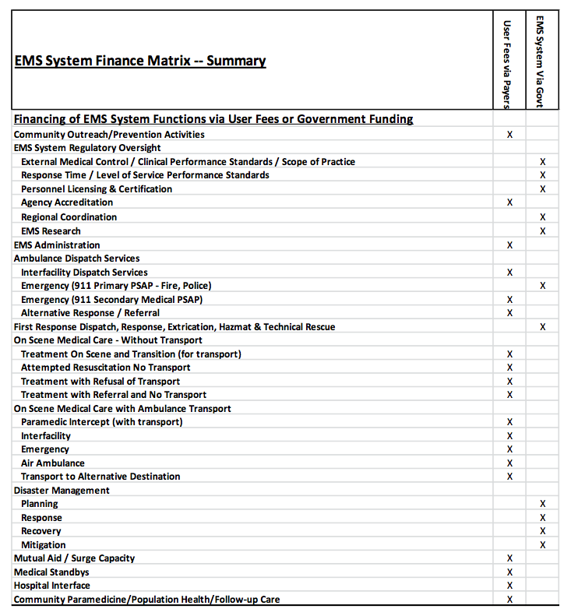

Slide 22
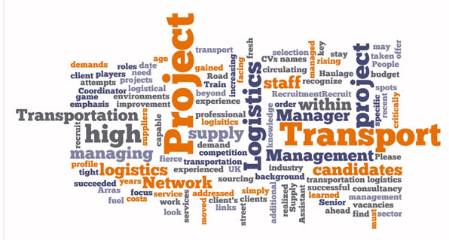
Logistics & Safety BP’s

Slide 23
Logistics & Safety BP’s
Swiss Army Knife Concept
One vehicle…many things
CEMS Specific Innovations
Ambulances
Psychiatric transportation & safety
Anti patient drop engineering
Retrofitting old stretchers and MCI bench seat
CNG Ambulance
Support vehicles
Resupply, decontaminate, maintain, first respond (BLS), evacuate, transport & plow!
Mobile cleaning platform

Slide 24
Logistical & Safety BP’s
Swiss Army Knife Concept
As many vehicles as possible can do as many things as possible
Eliminates need for service line bifurcation which drives inefficiency and waste
Much cheaper to outfit each ambulance to the same level then to pay for low productivity, over the depreciation lifespan of the equipment
Empowers marginal service provision vs. dedicated service provision
Gain economies of scale from this approach

Slide 25
CEMS Specific Innovations
Paul Power, EMT-P
Assistant Director of Operations – Logistics, Fleet, Safety, Special Programs
North Shore – LIJ Center for EMS

Slide 26
CEMS Innovation Genesis
Solutions to problems we actually experienced
Founded from health care based Root Cause Analysis (RCA) processes
Founded on sound financial & operational sustainability models
Founded on best practices and new innovations
Patient & employee focused resolutions

Slide 27
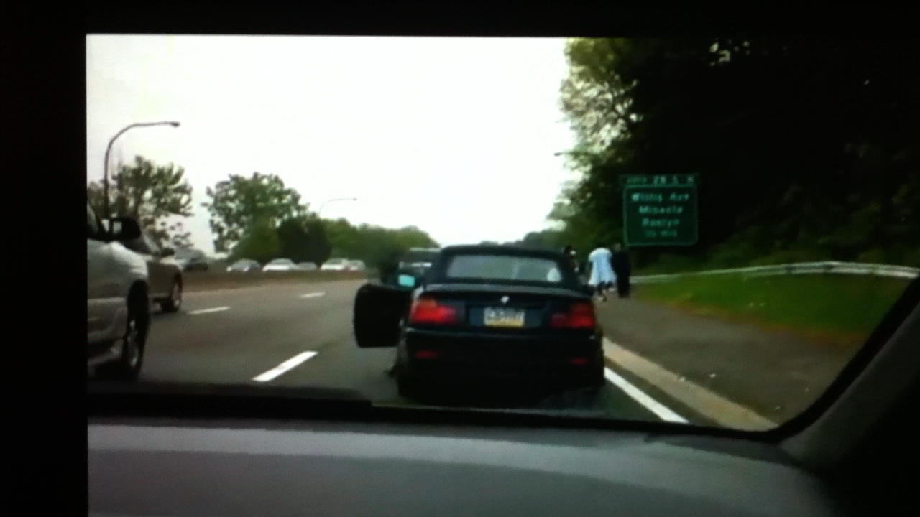
What Would You Do?

Slide 28
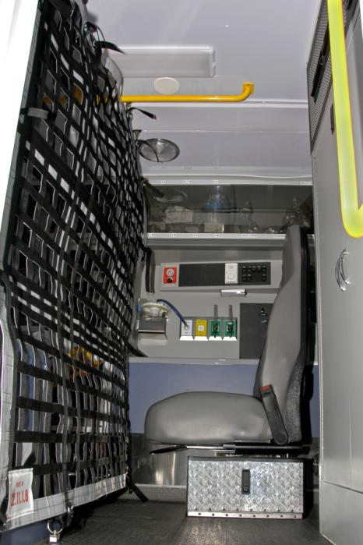
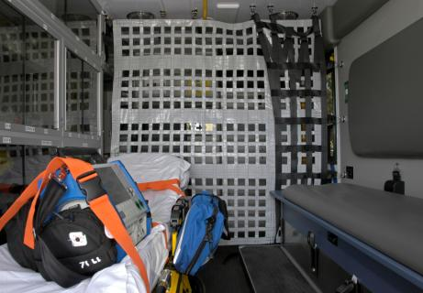
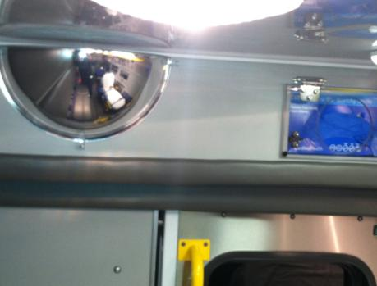
CEMS Specific Innovations
Ambulance
On demand conversion of an ambulance into a safe psychiatric inter-facility transport unit

Slide 29
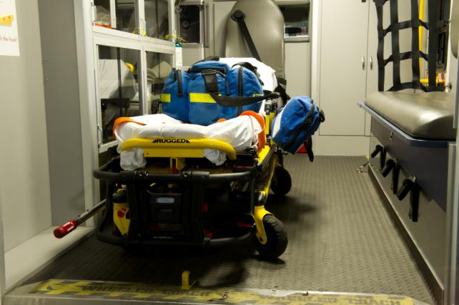
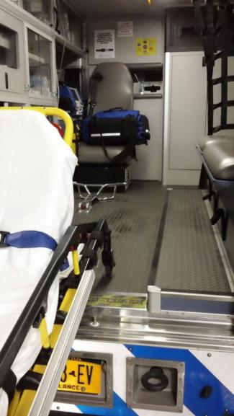
CEMS Specific Innovations
Ambulance
Anti patient drop engineering
Before
After

Slide 30
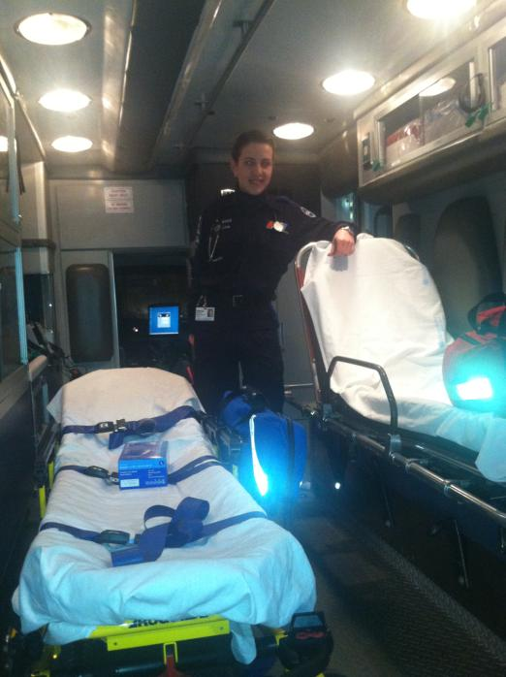
CEMS Specific Innovations
Ambulance
Post Irene Innovation
Used during Sandy Evacuations
Conversion of old stretchers for MCI transport

Slide 31
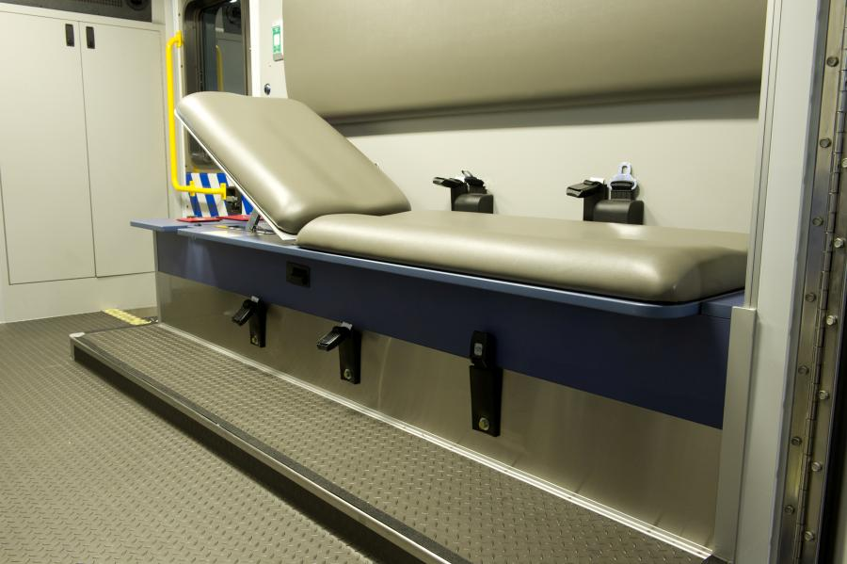
CEMS Specific Innovations
Ambulance
MCI Bench seat innovation (Post Irene)

Slide 32
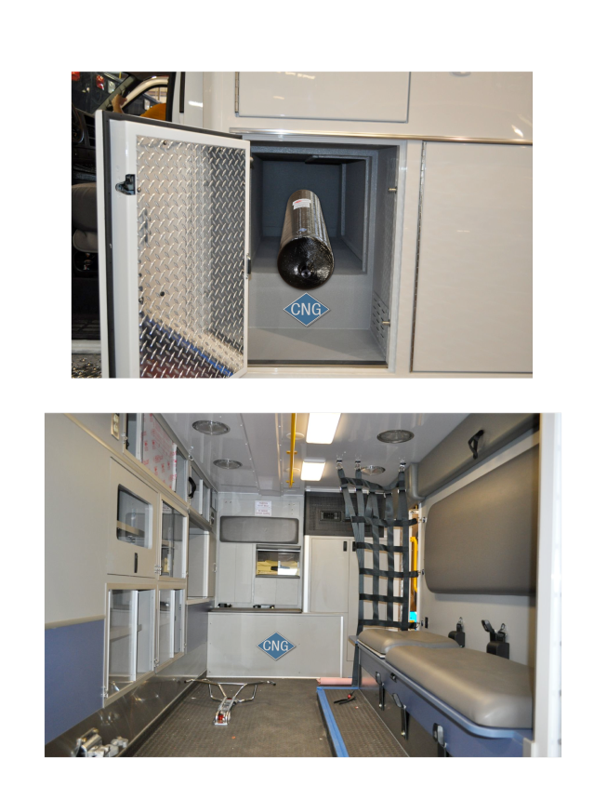
Specific Innovations
Green Initiative
CNG Ambulance

Slide 33
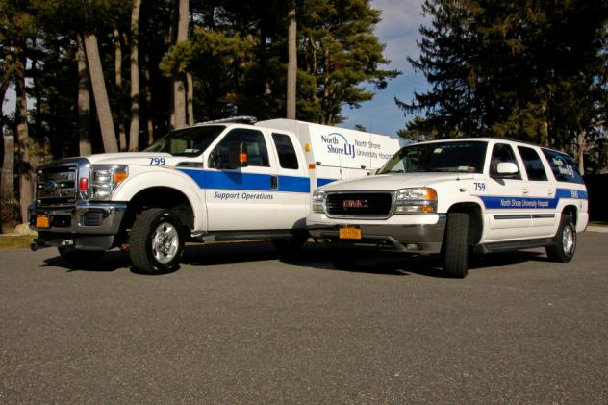
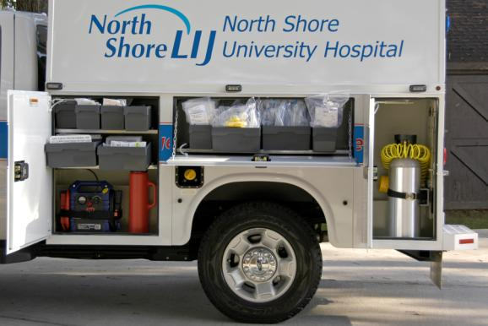
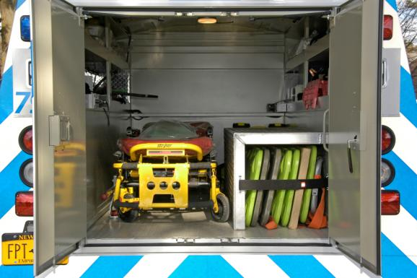
CEMS Specific Innovations
Support Vehicles
Resupply, decontaminate, maintain, first respond (BLS), evacuate, transport & plow!

Slide 34
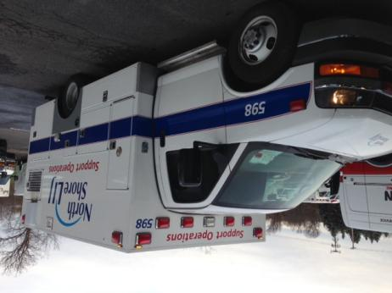
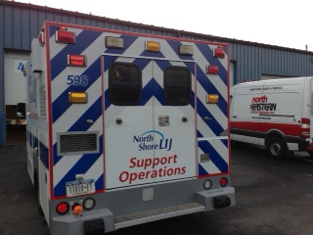
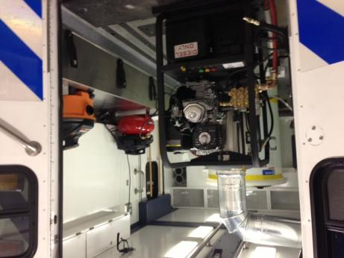
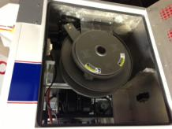
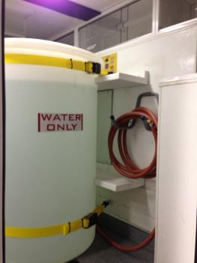
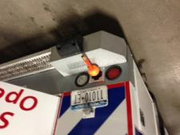
Specific Innovations
Support Vehicles
Newest Innovation: Mobile cleaning platform

Slide 35
Emerging BP’s from last year NOW today’s reality
Benchmarking & quantification of quality
Population based reimbursement
Health system integration of EMS

Slide 36
Emerging BP’s from last year NOW today’s reality
Benchmarking & Quantification of Quality
Clinical outcomes
Financial outcomes
Operational outcomes
Customer satisfaction
Employee satisfaction
Stakeholder satisfaction

Slide 37
Emerging BP’s from last year NOW today’s reality
Benchmarking & Quantification of Quality
Outcomes (Clinical, Operational, Financial)
Quantify what truly matters
Use information to drive:
Change / continuous improvement
Innovation
Quality
Transparency vs. clandestine approach
Benchmark against yourself and with willing others
Build a portfolio to share & market

Slide 38
Emerging BP’s from last year NOW today’s reality
Benchmarking & Quantification of Quality
Satisfaction (Patient, Employee, Stakeholder)
Quantify using standardized tools / approaches (e.g. EMS Survey Team)
Use information to drive:
Customer loyalty
Turnover reduction & culture
Build alliances and allegiances
Service differentiation from competitors
Benchmark against yourself and with willing others
Use statistically valid sampling to authenticate results

Slide 39
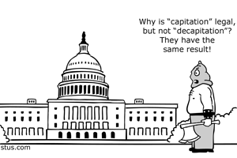
Population Based Reimbursement
Emerging BP’s from last year NOW today’s reality

Slide 40
Population Based Reimbursement Background
Managed Care Roots
Traditional Managed Care = Insurance companies hold $$$ and control
ACO / SSP = Providers or groups of providers hold $$$ and control
Program Intent
Realign economic incentives from FFS to Care Coordination of a population
Improve care efficiency, effectiveness, integration and transparency while also ensuring quality
Cost avoidance
Focus on preventative vs. reactive medicine
Alternative Reimbursement Methodologies
Accountable Care Organizations (ACO)
Shared Savings Programs (SSP)
Bundled Payments
At Risk Capitation for Patient Populations

Slide 41
Population Based Reimbursement
Emerging EMS Integration Pathways
EMS Claims Data
Stratify data by payer source & clinical conditions
Look for trends that provide savings opportunity for the payer both in field and downstream
Identify and cost quantify frequent flyers and their downstream impacts
Financially quantify all assumptions
Approach them first
Common Denominators: Claims Transparency, Benchmarked Quality, Fiscal Prudence, Downstream Impacts
What can YOU do for them AND get paid for it in return
Remember they can decide much of the reimbursement rules

Slide 42
Population Based Reimbursement Negotiation Take-a-way’s
Be ready, willing and able to do a proof of concept with the payer's local patient population to show how you can provide downstream savings
Put yourself in the shoes of the downstream stakeholders to try and figure out what you can do for them to save dollars (it's about cost avoidance)
Have lot's of data available about the patient population you are targeting (usage patterns, costs of traditional vs costs of revised models)
Patient satisfaction is paramount and must be measured and reported out on any program. ACO's will not team up with you if patients are going to reject the type of service being provided.
Be willing to share successes and failures (transparency) at all levels internally and externally
Be ready, willing and able to go at risk for shared cost savings reimbursement methodologies vs fee for service methodologies
Courtesy of Matt Zavadsky – MedStar, Fort Worth, TX

Slide 43
Emerging BP’s from last year NOW today’s reality
Health system integration of EMS
It’s the early days of integration
Explosion in consulting growth
Hospitals seeking guidance on EMS system integration
Mergers and acquisitions of private EMS agencies and healthcare systems continue to grow
Many hospital based EMS programs that were seen as loss leaders, now getting attention of senior hospital administration
Integration of EMS call centers as continuum of care coordination centers

Slide 44
Emerging & Future BP Predictions

Slide 45
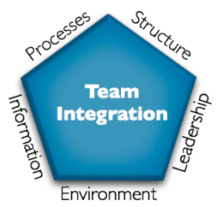
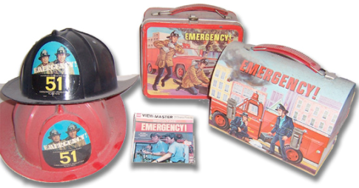
Emerging and Future BP Predictions
Full EMS Integration into Health Care
Integrated Clinical Call Centers
Locus of Care Navigation
Escalation and de-escalation
Community Paramedicine
Shift from risk avoidance to risk tolerance
Back to Jonny & Roy days
Emergence of Field Telemedicine

Slide 46
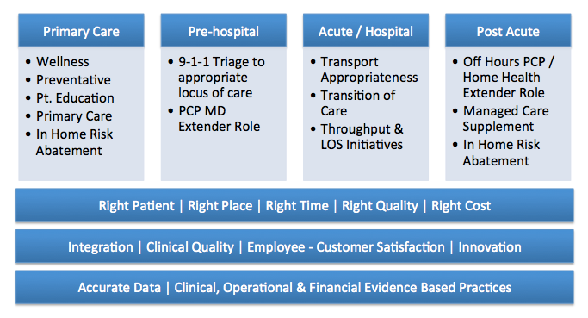
Emerging BP’s & Future BP Predictions
Full EMS Health System Integration

Slide 47
Continuum of Care Integration
Primary Care (Community Paramedics / Expanded Scope Paramedics)
Health, Wellness, Education, Risk Assessment & Avoidance
Fill gaps in existing coverage (rural)
Pre-hospital
9-1-1 Triage to appropriate locus of care (PSIAM)
Expanded Physician Extender role (Coordination of ED & PCP, Home Care, House Calls)
Shift from Risk Aversion to Risk Tolerance
Acute / Hospital
Transportation appropriateness (Medical Necessity)
Transition of care
Throughput and LOS impacts
Post Acute
Off hours services (call center, physician extender)
Managed care supplement (call center, at home)
In home risk identification and abatement

Slide 48
Innovative EMS Care Pathways
9-1-1 System
Call Center based systems (PSIAM) with alternative destinations / referral
Physician extender based response with alternative destinations / referral
Risk Stratified Discharge Enrollment
Disease specific case management
Transitions of care
Medication reconciliation
Mental health assessment
Social / support / in-home risk abatement
Off Hours Service Integration (PCP, Home Health, House Calls, Medical Home)
Physician extender based response with alternative destinations / referral
Frequent flyer identification, referral & mitigation
Community Health, Wellness & Education
Preventative
Immunizations
In-home education
Primary Care Role
Community Paramedicine
Expanded Scope Paramedics
Social / support / in-home risk abatement

Slide 49
The 5 R’s
Right Patient
Tag with cradle to grave EMR
Right Place
ED, Urgent Care, In Home, PCP Visit Next Day, Self Care
Right Time
Emergency, Urgency, Delayed, Scheduled
Right Quality
MD/DO, NP, PA, RN, EMT-P, Social Services, Self/Care Giver
Right Cost
Effective care at the most efficient mechanism of delivery

Slide 50
Some Early Wisdom….
The words “expanded scope” scare the crap out of existing community providers (MD, RN, NP, PA)
Why?
Urban vs. rural “Community Paramedic” programs are evolving differently (and they should)
Rural
Primary care
New educational curriculum
Provide services not currently available in the community
Where “expanded scope” might work
Urban
Physician extender role NOT expanded scope role
In-home clinical decision support
Supplement & enhance existing services
Alternative destinations

Slide 51
Some Early Wisdom…
If the program costs more then it saves, it’s not going to work
Programs evolving as either “dedicated” or “marginal”
Dedicated programs:
Dedicated resources used for these types of programs (single medic fly car)
Cost per visit based on utilization & fully loaded costs so often more expensive model
Greater clinical focus & specialization
Marginal programs:
Performed off the margin of existing EMS resources (Ambulance Unit Hours or Supervisors)
Much lower cost per trip as productivity is shared with EMS system and service is provided on a marginal cost basis
Lowered clinical focus & specialization

Slide 52
Some Early Wisdom…
Back to Johnny & Roy days
Physician extender role of EMS is key to success
EMS will have to take a step back to consultation driven treatment decisions (medical control) and not protocol driven (for now)
EMS refusals against medical advice will shift to EMS cancellation with medical advice
4G technologies & hardware will enable a new type of EMS telemetry – telemedicine
Expansion of point of care testing capabilities essential for future success
Lab values
Decision support systems require detailed objective and subjective clinical information in order to make an informed and safe decisions

Slide 53
Remember…
These programs are about saving dollars and NOT creating for the sake of creating
These programs are about saving dollars and NOT about sustaining 200 years of service unencumbered by progress
These programs are about saving dollars and NOT sacrificing clinical quality which many do not believe go hand in hand, but they can

Slide 54
Why Does EMS Need Best Practices
“As EMS providers, we invite the public to literally trust us with their lives. We advise the public that, during a medical emergency, they should rely upon our organization, and not any other. We even suggest that it is safer to count on us, than the resources of one’s own family and friends. We had better be right.
Regardless of actual performance, EMS organizations do not differ significantly in their claimed goals and values. Public and private, nearly all claim dedication to patient care. Efficient or not, most claim an intent to give the community its money’s worth. And whether the money comes from user fees or local tax sources, the claim is the same—the best patient care for the dollars available. It’s almost never true.
Our moral obligation to pursue clinical and response time improvement is widely accepted. But our related obligation to pursue economic efficiency is poorly understood. Many believe these are separate issues. They are not. Economic efficiency is nothing more than the ability to convert dollars into service. If we could do better with the dollars we have available, but we don’t, the responsibility must be ours. In EMS, that responsibility is enormous—it is impossible to waste dollars without also wasting lives.”
Jack L. Stout

Slide 55
Urban EMS Call of the Future
9-1-1 @ 2am on a Saturday for a call for dyspnea (chronic CHF patient)
9-1-1 center flags patient as low acuity (due to chronic condition) but not self treatable
Patient shunted to 9-1-1 de-escalation protocols administered by higher level clinicians
Cold EMS response with medic conferencing a plan & ED physician once on site for medical direction
Physician extender role
Telemedicine management
Point of care testing
In home treatment & call center based follow up
Referral and appointment to PCP in AM

Slide 56
EMS Technology Innovations

Slide 57
EMS Technology Innovations
The cloud for EVERYTHING!
CAD is officially in the cloud
All-in-one flexible clinical and operational decision support systems are the future
Smart-Care
Mobile Healthcare Innovations
Ferno’s phased plan for the future
ROIP, LMR & Mobile 4G Integrations
Wave Mobile
Life EMS in Michigan & AEV
Patient & safety focused vehicle

Slide 58
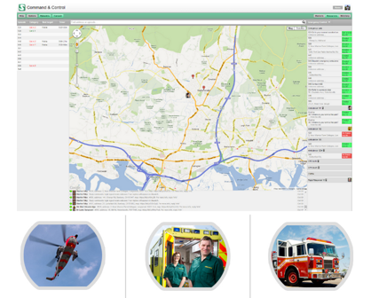
https://care.smartdaygroup.com/

Slide 59
Emergence of all-in-one integrated clinical & operational data systems
Cradle to grave clinical datasets:
Master Patient Index
EMR / ePCR
All encounter types (EMS, MD, testing, etc.)
Clinical and Operational Algorithms
OTS Integration (PSIAM, ProQA)
Customizable designs and workflows
“App store” for selling and purchasing custom clinical and operational algorithms
Built in telephony

Slide 60
Comprehensive & integrated feature sets:
Dispatch (CAD)
Call recording
Custom & OTS integrated decision support
Custom forms
Directory of services using social media like engine with call hand-off capabilities
Patient scheduling / provider rostering
Seamless delivery on browser & apps for all mobile platforms
Clinical information routing & sharing
Built-in texting capabilities
Reporting
Billing

Slide 61
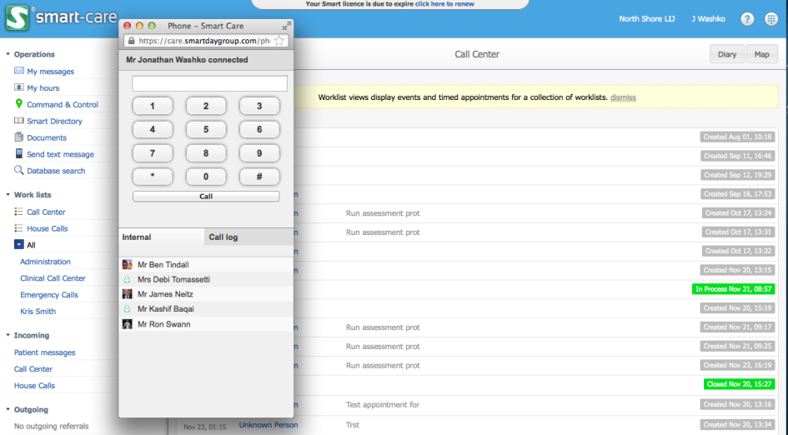
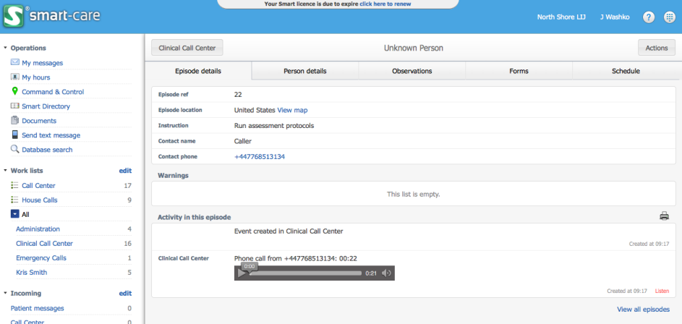

Slide 62
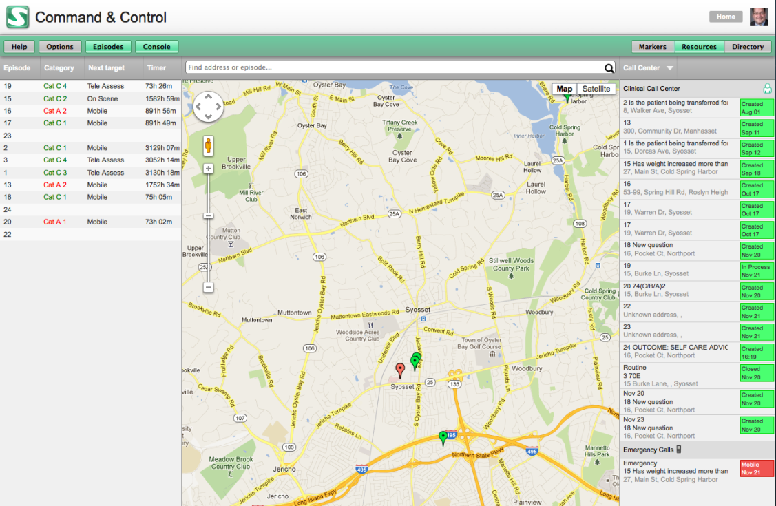

Slide 63
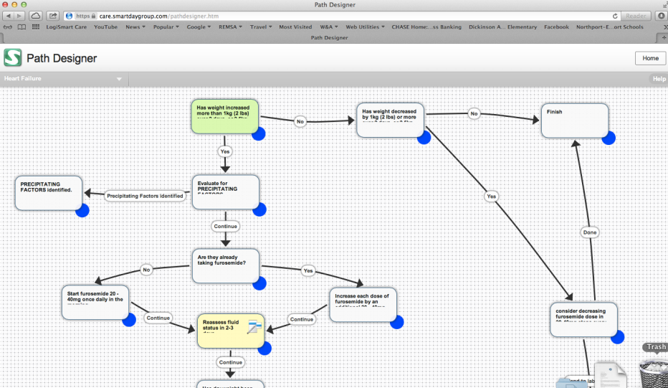
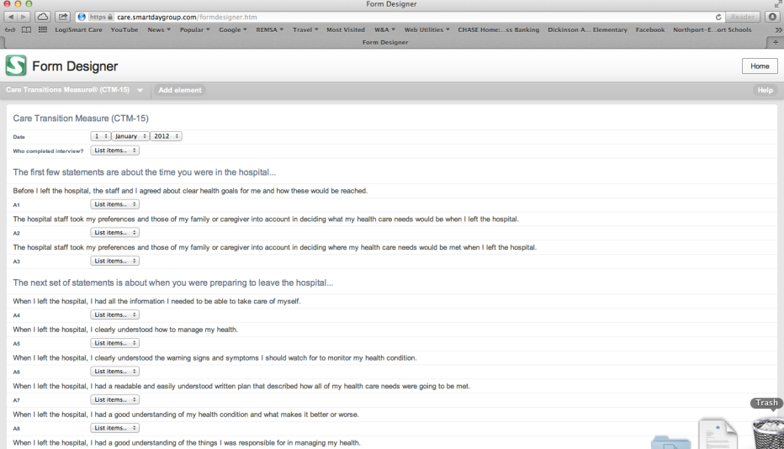

Slide 64
A Recent Visit to Ferno’s Customer Experience Center
http://www.fernoems.com/

Slide 65
A Recent Visit to Ferno’s Customer Experience Center…
2020 Vision for the Ambulance of the future
7 phases over 10 years
Phase 3 set for 2013
Integrated Patient Transport System
4 key components
Patient Transport System (Mondial & iN∫X)
Medic Seating System (TBD)
Ambulance Environment System (iN∫Traxx, iN∫Paks & iN∫Mounts)
On-board Intelligence (ACETech)

Slide 66
A Recent Visit to Ferno’s Customer Experience Center…
iN∫X Powered Ambulance Cot
The only cot that can lift and load a patient into any ambulance
Does not require an in-vehicle track system
Key features include
All Level Power Lift System
Integrated Loading and Transport System
Surround & Drive Lighting System
Enhanced Patient Restraint System

Slide 67
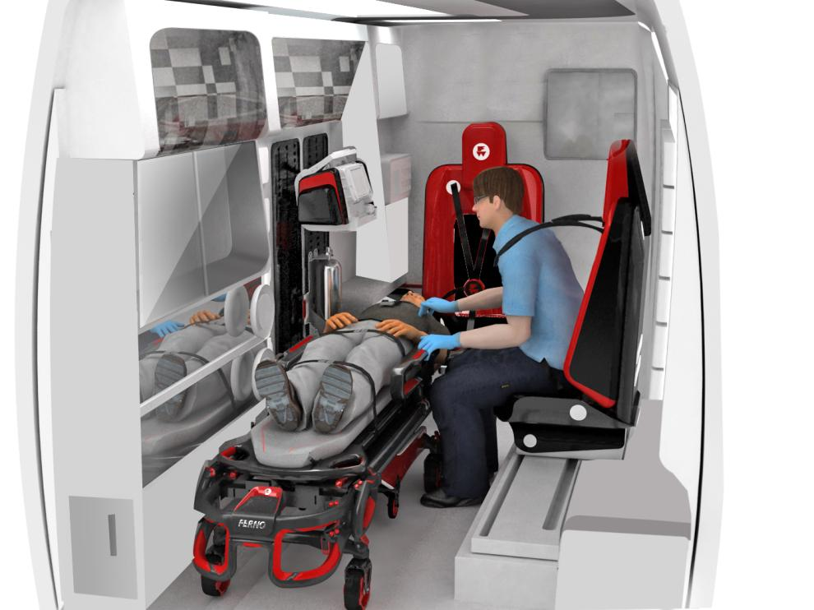
A Visit to Ferno’s Customer Experience Center…

Slide 68
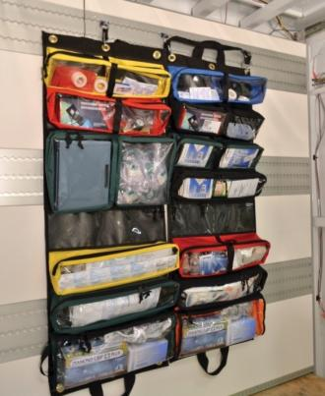
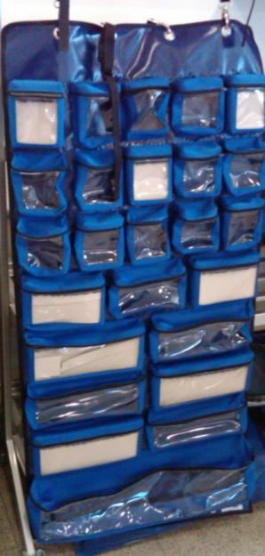
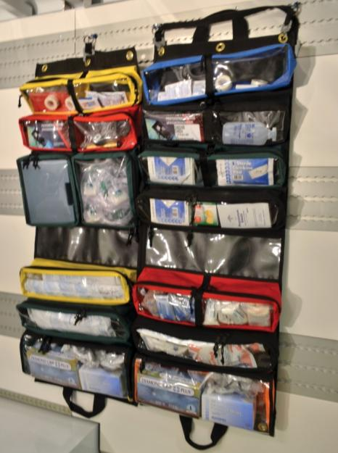
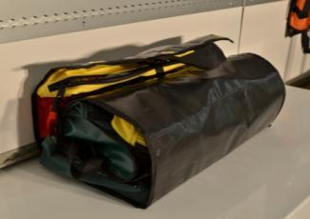
A Visit to Ferno’s Customer Experience Center…
iN∫Pak kits

Slide 69
Integration of Old & New Radio Systems
http://www.twistpair.com

Slide 70
Seamless Integration of Old & New

Slide 71
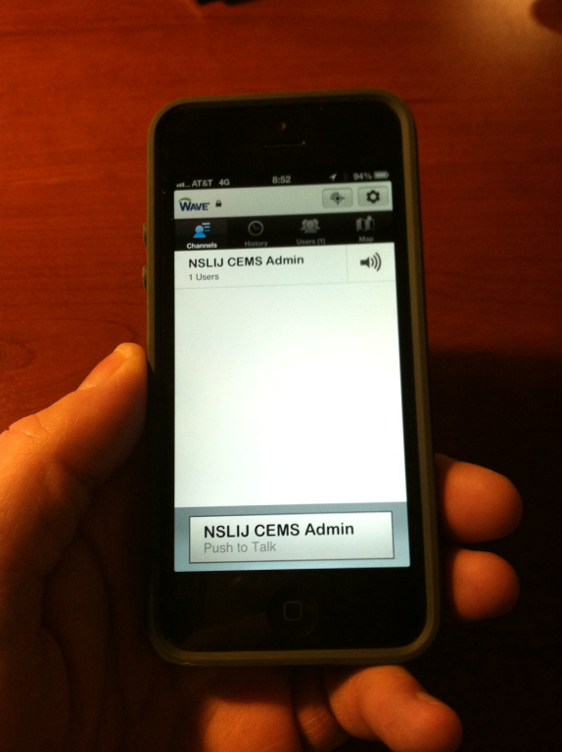
PTT iPhone Application

Slide 72
Life EMS & AEV

Slide 73
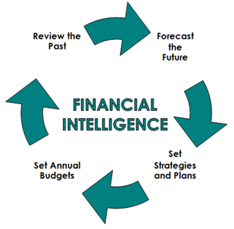
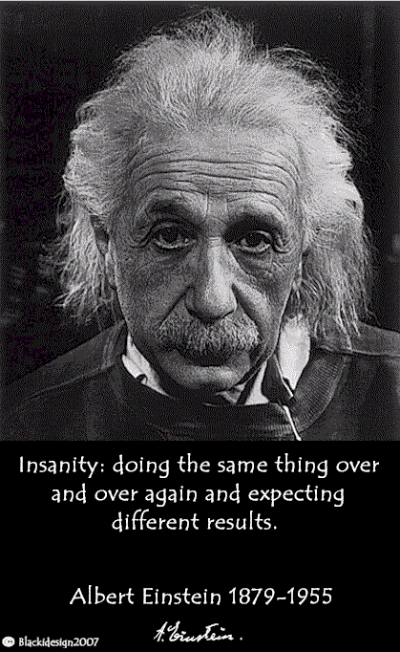
Worst Practices in EMS

Slide 74
Worst Practices in EMS
Thinking that healthcare reform will never happen
It is here and not going away as the current system is not sustainable
Not being at the table with your local healthcare system(s) NOW!
When the music stops you may be without a chair
Teach and inform them of EMS’s mobile healthcare value proposition & opportunities
It’s not just about transportation anymore!

Slide 75
Worst Practices in EMS
Not understanding your business at a granular financial level
Includes revenues & expenses
Should know what part of your business is a cash cow, what is self-sustaining and what is loosing as these various financial states should help guide decision making within the organization
Unveils tough decisions that may need to be made
Enables mission vs. margin discussions
Can help set short and long-term strategies

Slide 76
Worst Practices in EMS
Not understanding that we have seen the peak of reimbursement dollars which will now continue to decline under the current reimbursement systems and schemas
We must work to reform NOT maintain
CMS based EMERGENCY medical necessity audits are already here!
Waiting for federal reimbursement policies to drive innovation and change in private reimbursement policies
Private sector will innovate before the government (they already are)
Field of golden opportunities if you have the organizational agility and intestinal fortitude

Slide 77
Worst Practices in EMS
Not knowing what you don’t know
Unconscious incompetence
None of you fall into this category as you are all here
Knowing what you don’t know and then doing nothing about it
Conscious incompetence
Don’t end up here, when you go home, take action!
Remember that the definition of insanity is doing the same thing over and over and expecting different results

Slide 78
Questions?
Paul Power, EMT-P
Assistant Director of Operations
North Shore – LIJ Center for EMS
ppower@nshs.edu | 516-719-5033
Jonathan D. Washko, BS-EMSA, NREMT-P, AEMD
Asst. Vice President of Operations
North Shore – LIJ Center for EMS
jwashko@nshs.edu | 516-719-5042

