Slide 1
Best Practices in EMS
Part Duex – In High Definition
Jonathan D. Washko, BS-EMSA, NREMT-P, AEMD
Assistant Vice President – Center for Emergency Medical Services
North Shore – LIJ Health System
President & CEO – Washko & Associates, LLC
Partner & Shareholder – FirstWatch, LLC

Slide 2
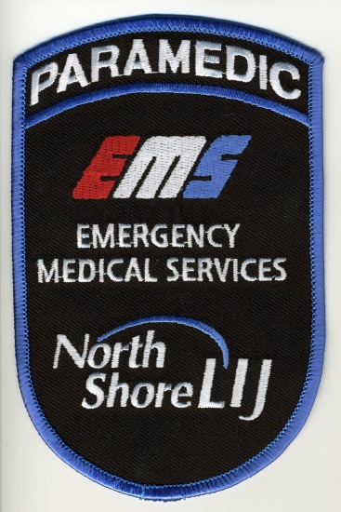
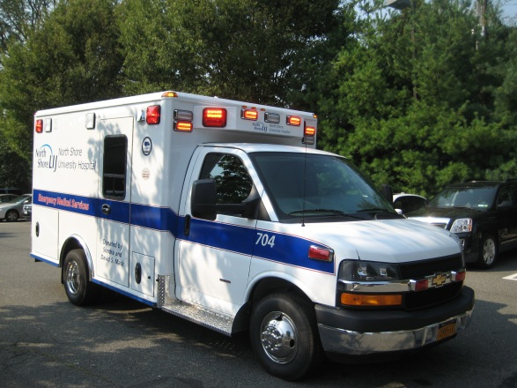
About Us…
Located in NYC / Long Island Region
Highly competitive marketplace
600+ Employees and growing
100+ Vehicles and growing
100,000+ Annual call volume and growing
$40M+ Annual budget

Slide 3
About Us…
9-1-1 Programs (FDNY & Municipal)
Inter-facility / CCT-SCT / Private Emergency
Training / Command & Control / Billing / PI
Multiple deployment centers throughout region
Defining a new category of EMS system design
  “Healthcare System” Based EMS Agency
  On the bleeding edge of “Systems” of care based healthcare under ACA / HCR
  Coordinated network management of patients
  Have a seat at the table (untraditional)

Slide 4

About Us…
Our “Cradle to Grave” Healthcare System
  4 Tertiary Hospitals
  11 Community Hospitals
  1000’s Doctors / Clinics
  Nursing Homes / Rehabs / Home Care / Hospice
  Internal and External Pharmacies
  42,000+ Employees
  Revenues of $6B+
  2nd Largest Not for Profit Secular Health System in the United States
  Partially Integrated working towards complete integration

Slide 5
Best Practices in EMS
Part Un (The Original)
In Best Practices Part I (In case you missed it)
  Low Def discussion on: Operations, Deployment, EMS System Design, Fleet Maintenance, Training, Quality Improvement, Billing, Communications, Technology, Administration, Human Resources
  Part I presentation available at
    http://washkoassoc.com/knowledgebase.aspx

Slide 6

Best Practices in EMS
Part Duex – In HD
What is a Best Practice
Why Does EMS Need Best Practices
Best Practices – Shared
  Smaller number but in greater detail
  Success Common Denominators
Emerging & Future Best Practices
  Acknowledge ACA / HCR
  Matches our theme
Share Your Best Practices

Slide 7
What is a Best Practice
A Best Practice is the belief that there is a technique, method, process, activity, incentive or reward that is more effective at delivering a particular outcome than any other technique, method, process, etc. The idea is that with proper processes, checks, and testing, a desired outcome can be delivered with fewer problems and unforeseen complications. Best practices can also be defined as the most efficient (least amount of effort) and effective (best results) way of accomplishing a task, based on repeatable procedures that have proven themselves over time for large numbers of people.

Slide 8
Why Does EMS
Need Best Practices?
Service delivery model variations / inconsistencies
Lack of commonly accepted operational standards (like NFPA for Fire Service)
Mix of public / private / government ownership
Mix of for profit / non-profit models

Slide 9
Why Does EMS
Need Best Practices?
Lack of standardized advanced managerial education platform
Industry has attempted to bridge educational gap with limited success
Success lies in sharing some clinical & billing best practices but not operational ones

Slide 10

Best Practices – Shared
Successful EMS Agency Common Denominators
  Customer Service
  Employee Well-being
Safety & Risk Management
Human Resources
Information Technology (my favorite and always something new to talk about)

Slide 11
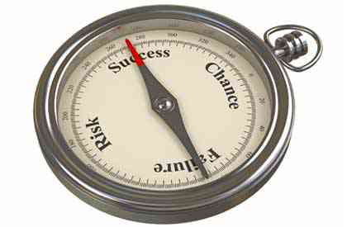
Successful EMS Agency
Common Denominators

Slide 12
Successful EMS Agency Common Denominators
Leverage many of the pragmatic / tangible programs and methodologies discussed in Best Practices - Part One
Also embrace the concept of the EMS Success Triad
  Whether you call it this or not

Slide 13

EMS Success Triad
Balancing of
  Patient Care
    Clinical sophistication
    ***Customer Service
  Employee Well-being
    Compensation
    ***Health / safety / welfare
  Financial Stability
    Properly designed service delivery system
    Revenue maximization

Slide 14
Customer Service
What do our customers truly care about?
  On time performance / timeliness
  Service reliability & consistency
  Look & feel of providers
  Professionalism of interaction (bedside manner)
  Ride comfort in back of ambulance
  Ambulance cleanliness and organization

Slide 15
Customer Service
But you forgot clinical…
  Remember most patients assume they will receive good clinical care
  Have no other frame of reference other than customer service related experiences
  We hear about clinical issues when…
    We do something really - really good
    We do something really - really bad

Slide 16
Customer Service
Common denominators of successful EMS agencies include:
  Spend more money on uniform quality and durability than others
  Pay attention to details on ambulance layout, look, restocking, cleanliness and maintenance
  Provide superior customer service training and organizational culture / focus
  Have solid clinical & training programs
  Seek external feedback, validation & benchmarking
    Accreditation & Surveys

Slide 17
Employee Well-being
Common denominators of successful EMS agencies include:
  Truly care about what happens with their people
  Embrace, understand and leverage generational differences
  Have consistent, intentional contact with management
    Flow engineering of building
    Ride-a-longs
    Team meetings / interactions
  Employee input is valued, acted upon, compensated for, embraced and sought after

Slide 18
Employee Well-being
Common denominators of successful EMS agencies include:
  Supplement employee shortcomings
    Personal financial management training
    Coaching / mentoring programs
    Education beyond clinical opportunities
    Solid EAP programs / Psychological support
  Performance improvement
    Tie performance to shift bid weighting
    Pay for objectively based performance

Slide 19
Employee Well-being
Common denominators of successful EMS agencies include:
  Recognition / reward programs
    Employee involvement
    Public recognition on jobs well done
    Sharing of letters from patients and family
    Shameless promotion of good stories and outcomes
  Fairly and consistently applied rules, regulations and consequences
    No good ole boy syndrome

Slide 20
Employee Well-being
Common denominators of successful EMS agencies include:
  Workload management and load balancing
    UHU monitoring
    Real-time equal distribution of NET
  UHU “sweet spot” balance governance
    Once found, stay in the zone
  EOS late call mitigation strategies
    Actively monitor, RCA and mitigate

Slide 21
Employee Well-being
Common denominators of successful EMS agencies include:
  Vehicle cab design
    Acknowledge employee time spent in vehicle
    Crew comfort engineered into cab design
    Safety important consideration
    Ergonomics
    Creature comfort needs addressed & met
      DVD / iPod / AC-DC Power / Internet Access
    Properly maintained seating / arm rests
    Cup holders

Slide 22
Employee Well-being
Common denominators of successful EMS agencies include:
  Flexible schedules that minimize days worked
    3 day work weeks
    Many in EMS have “B” or secondary jobs
    Consider work from home programs with A/R staff
  Routine employee appreciation “events”
    Cook-outs / socials / holidays
    Gift cards (Food, Drinks, iTunes)

Slide 23
Employee Well-being
Common denominators of successful EMS agencies include:
  Family involvement & recognition of needs
    Active military family support
    Invitation to participate in company events
    Flexibility in dealing with family emergencies
    Acknowledgement of life-altering events
      Births / deaths / marriages / divorces

Slide 24
Employee Well-being
Common denominators of successful EMS agencies include:
  Employee Health
    Tie financial rewards to entice healthier lifestyles, risk assessments and preventative treatments
      Per pay period benefit rebate for anti-smoking, annual physical, flu shots (it works)
    Weight mitigation
      Biggest looser / weight watchers
      Support / tools / education

Slide 25
Employee Well-being
Biggest challenge with no easy solution…
  Communications with staff in a 24x7 geographically dispersed environment
    Email communication not accepted by younger generation
    Social media has some potential to bridge gap
    “AIMS” may be a piece of the solution (more on this later)
    Multi-media / multi-sourced approaches
      ??? results
    Always on lookout for “Best Practices”

Slide 26
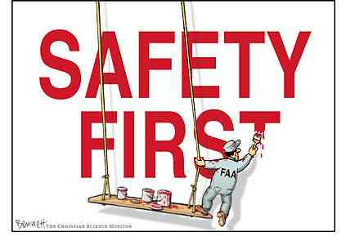
Safety & Risk
Management / Mitigation

Slide 27
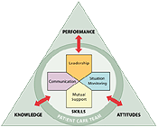
Safety & Risk
Management / Mitigation
Embracing healthcare based safety systems in EMS
  National Center for Patient Safety
    Prevention and mitigation strategies
  TeamSTEPPS
    Aviation based Crew Resource Management (CRM) but designed for Healthcare
    Developed by Dept. of HHS

Slide 28
Safety & Risk
Management / Mitigation
Situation:
  On routine inter-facility transport of a voluntary psychiatric commitment patient, EMS crew and bystanders (who stopped to assist the crew) were viciously assaulted by the patient
  Attack was completely unprovoked and unanticipated
  Paramedic was beaten with ePCR Panasonic Tough Book and patient fists
  Patient then stole a car of off-duty police officer and was later apprehended after crashing vehicle in NYC

Slide 29
How would EMS traditionally react to a situation like this?
Investigate
  Extremely low probability situation
  No fault / not predictable
Reaction
  Possibly provide additional training
  Policy / procedural changes
  Ignore and do nothing but mourn situation

Slide 30
How Healthcare
Would Respond
Initiate an independent root cause analysis (RCA) of the situation
Entire “system” of care involved in analysis from start to finish
Cause & Effect determined
Look how best to fix
Make necessary changes to prevent recurrence
Measure outcomes

Slide 31
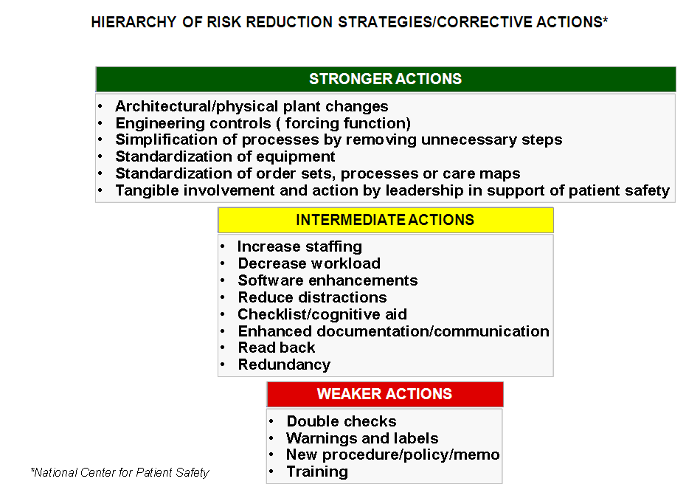
How Healthcare Would Respond

Slide 32
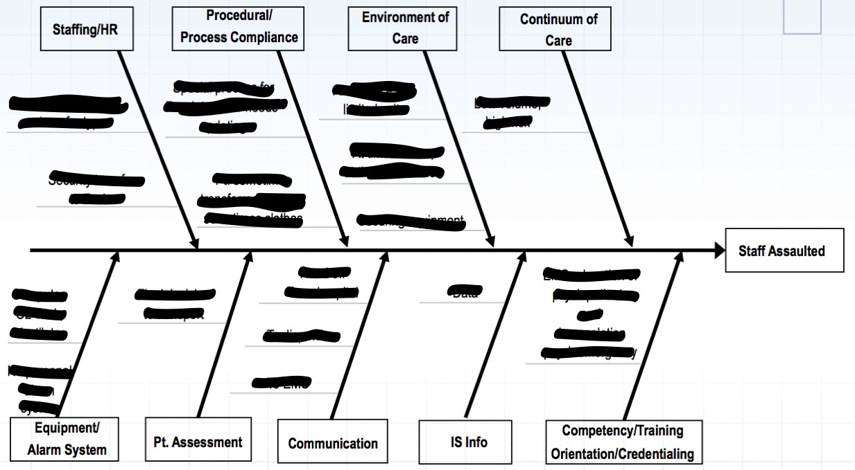
RCA Cause & Effect

Slide 33
Our Epiphany
Most psychiatric patients in hospitals are placed into access controlled rooms, that are “sterile” of medical equipment, cords, etc. of which the patient could hurt self or others
But when transporting, we place these patients in a cage, with limited exits, with weapons (medical equipment), with our employees in a magic vehicle called an ambulance and believe nothing will ever happen

Slide 34

How a Healthcare System based EMS Agency did respond…
De-escalation training
Self defense training
TeamSTEPPS training
New policy & procedure

Slide 35

How a Healthcare System based EMS Agency did respond
Pre-transport “huddle” by sending transport clinicians and EMS staff
Use of standardized risk assessment scripts / tools at intake & bedside

Slide 36

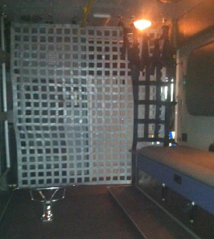
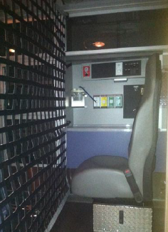
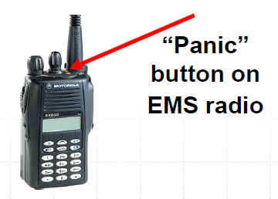
How a Healthcare System based EMS Agency did respond…

Slide 37
How would EMS traditionally react to a situation like this?
Recurrent patient drops due to stretcher hook not catching when removing patient from back of ambulance

Slide 38
How would EMS traditionally react to a situation like this?
Investigate
  At fault / predictable situation
  Moderate risk / frequency
Reaction
  Check equipment (stretcher height)
  Retraining (provider fault)
  Hope it doesn’t happen again

Slide 39
How Healthcare Would Respond

Slide 40
How would EMS traditionally react to a situation like this?
Investigate
  At fault / predictable situation
  Moderate risk / frequency
Reaction
  Check equipment
  Retraining (provider fault)
  Hope it doesn’t happen again

Slide 41
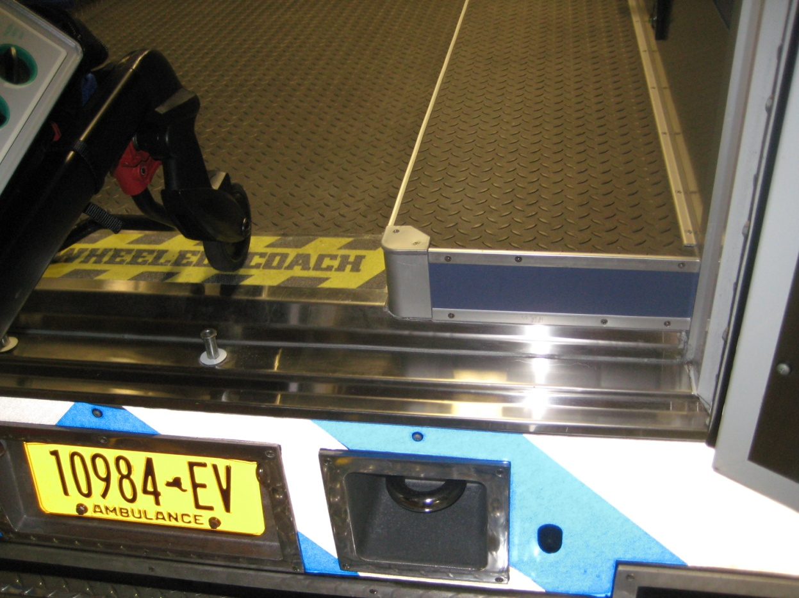
How a Healthcare System based EMS Agency did respond…

Slide 42
Takeaway from these examples
I learned something new from another part of healthcare
Best practices can be found outside the industry that are applicable to EMS
Engineering solutions are stronger than all of the traditional responses to risk events that I have used in the past combined

Slide 43
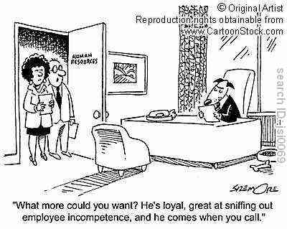
Human Resources

Slide 44
Human Resources
Candidate selection with psychological screening
  Detect positive and negative behaviors
  Customer service predisposition
  Risky behavior predisposition
  Skills / ability confirmation
    AVESTA / Crit-i-call
Lecture on this topic later by SeniorCare on Wednesday morning

Slide 45
Human Resources
Reworking of traditional EMS Orientation / FTO Programs
  Traditional 1 - 2 weeks of class orientation
  Long FTO Ride-a-long
  Employee released by FTO to field
Problems with this approach
  Employees don’t receive consistent didactic content
  Subjective review of field “readiness” based on variably applied criteria
  Inconsistent results / unreliable throughput

Slide 46
Human Resources
Training Academy Approach
  FD/LE/Military based concept
  Enough classroom time to complete and confirm total didactic competencies (3-4 weeks)
  Use of simulation to teach and confirm psychomotor skillsets
  Field time for reality based verification of didactic and psychomotor skills competencies

Slide 47
Human Resources
Advanced Headcount Management
  Predictive gain / loss analysis process
  Inclusion of PTO / LOA / Workers Comp Loss
  PRN / PT weighting in calculations
  Routine meeting to discuss changes / needs
  Hire ahead of the anticipated loss curve

Slide 48
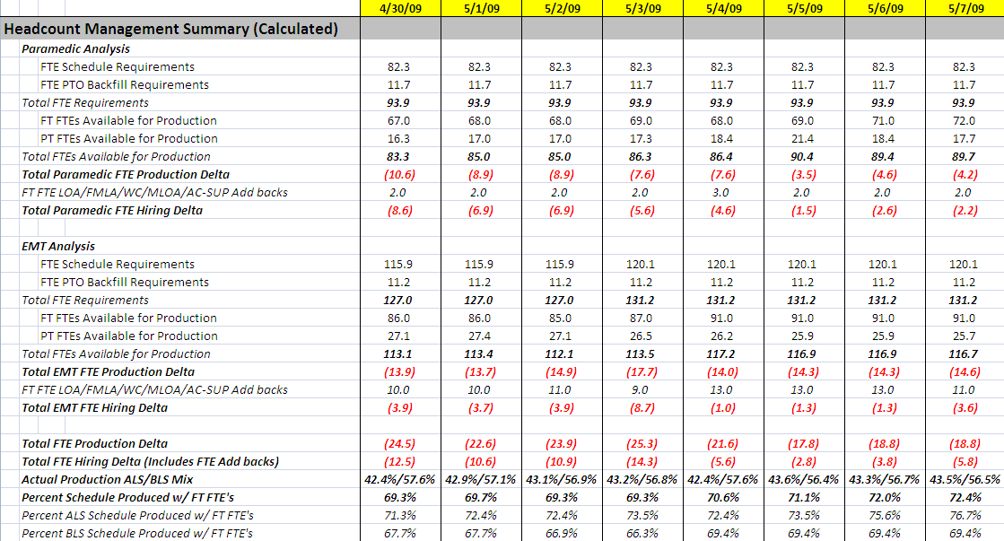
Advanced Headcount Management Example

Slide 49
Human Resources
Take-a-ways from these programs
  Traditional EMS orientation models are antiquated and need refreshing
  Better input process controls yield better output quality
  Quality of personality traits can be scientifically quantified vs. subjectively guessed at
  Skills and abilities can be objectively tested and benchmarked against a standard
  Proactive headcount management improves service reliability, decreases domino effects of loss of staff

Slide 50
Human Resources
Program Benefits
  Reduce turnover
  Reduce hiring & training expenses
  Consistency in process / education output
  Improve educational quality and assured content delivery
  Reliability / predictability in throughput time-lines
  Reduce / eliminate staffing related problems

Slide 51

Technology

Slide 52

Technology
Productivity improvement
  Rescue Time
    Real-time monitoring and feedback systems
    Silently watch and time all computer interactions
    Categorize activities into blocks of productive and unproductive time
    Asks what you did when away
    Provides feedback through reports, a scoring system, benchmark reporting and reward badges

Slide 53
Technology
Productivity improvement success suite
  Get Things Done (GTD) Methodology
    David Allen
  Omnifocus (Mac / iPad / iPhone)
    GTD Management System
  Evernote
    Your life long searchable on-line brain / memory
  37 Signals Basecamp / Highrise / Campfire
    Collaborative project management, CRM & communication system

Slide 54
Technology
Administrative Information Management Systems (A.I.M.S.)
  What they are not
    CAD, Billing, ePCR
  What they are
    Pretty much everything else (convergence)
    Commonly stove-piped systems brought together under one roof
    Leverage sharing of information databases
    Next cloud based technology to capture EMS $$$

Slide 55
Technology
A.I.M.S.
  Schedule management system
    Designed to meet EMS scheduling complexity
    Typically integrate into most payroll systems
  All aspects of employee information management
    Certification, Human Resources, Commendations
  All aspects of asset / inventory management
    Fleet, supplies, DME

Slide 56
Technology
A.I.M.S.
  All aspects of information management
    Incident reporting, Accident reports, Document archive
  Content delivery and management
    Training, CME, EE Communication, Memos, Announcements
  Clinical Improvement information management
    Clinical reviews, feedback tracking, remediation
  CAD / ePCR integration

Slide 57
Technology
A.I.M.S.
  Workflow driven (very important)
    Ensure follow-up and feedback loop closure
    “Check list” based approvals
  Most are customizable to agency needs
    Can add / delete what you want to use or not
    Customize nomenclature, workflows, data elements

Slide 58
A.I.M.S.
Upside
  Improve productivity, communication & information sharing across the enterprise
  Available 24x7x365
  Eliminates rework and redundancy inefficiencies
  Relatively inexpensive
  One password / URL !
Downside
  Emerging / new (unforeseen consequences)
  Single point of failure / loss
  Information security / sensitivity (most have customizable access levels)

Slide 59
A.I.M.S.
Examples
  9th Brain, eCore, EMS Toolkit, Sharepoint
Driving Industry trend
  Single use cloud-based systems being driven to this model or will merge with others to compete
  Benefits us as consumers as we get more for our money if the company adds features without additional expense

Slide 60

Emerging & Future Best Practices
Benchmarking
ACA / HCR / ACO
New Emerging EMS Markets

Slide 61

Benchmarking
Existing Commercial Systems
  Customer service
    EMS Survey Team
Existing Grass Root Based
  Operational
    Zoll
    CAEMSS
  Clinical
    AHA, STEMI, Stroke
  Financial
    Zoll / CAEMSS / AAA

Slide 62
Benchmarking
On the Horizon
  Industry based benchmarking defined by professional association consensus using independent management mechanisms to collect, maintain and report on data
  Commonly accepted definitions, anonymity, data integrity and data usefulness key hallmarks to success
  AAA is taking lead in driving this collaborative effort as a benefit to its members
    CAAS / CAEMSS / NREMT / Others

Slide 63
ACA / HCR / ACO
R/Evolutionary changes to reimbursement & patient care
If enacted could change our entire business model (innovators)
Will drive mergers & consolidation of EMS by healthcare systems and others
EMS not currently seen as even a blip on the HCR radar…however…

Slide 64
ACA / HCR / ACO
So why are VC companies pouring dollars into the purchasing of EMS firms?
  Understand the value in undervalued value
  Just because the Feds have missed the boat on what EMS can bring to the HCR table doesn’t mean private industry will
  Eventually healthcare & reimbursement companies will understand the value of EMS and who will control most of it then?
  Current system is not sustainable

Slide 65

Emerging Undervalued
EMS Markets / Capabilities
Gate keeping
  Financial
  Network
Population health
Network management
  In / within / out of
Ambulatory / post acute care follow up
Health systems integration

Slide 66
Emerging Undervalued
EMS Markets / Capabilities
Some of these concepts have been around for a long time
  AAA has had Expanded Scope guidance documents since 1990’s
  European health models have leveraged these strategies for quite some time and we can learn a lot from them
Economics have not been aligned to perpetuate these programs (mostly been altruistic in nature)
  F.F.S. models got us where we are today
  Accountability based savings models coming

Slide 67
Emerging Undervalued
EMS Markets / Capabilities
HCR fundamentally resets economic conditions of healthcare reimbursement making EMS capabilities highly valuable for downstream healthcare savings
  ACOs one possibility / mechanism
  Payment bundling into hands of a “new consumer” – the healthcare system
Come to our Wednesday afternoon session on the ABC’s of ACO’s to learn more…

Slide 68
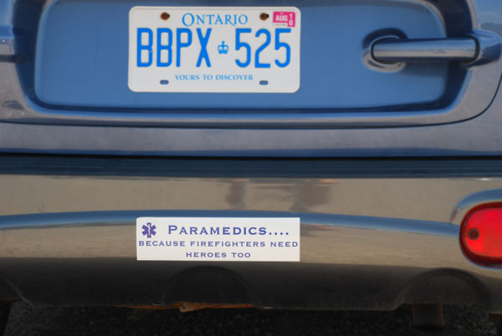
Share Your Best Practices…

Slide 69
Thank You!
Jonathan D. Washko, BS-EMSA, NREMT-P, AEMD
North Shore – LIJ Center for EMS
15 Burke Ln, Syosset, NY 11791
O: 516-719-5042 | C: 516-408-8063 | jwashko@nshs.edu

