Slide 1
Matching Supply to Demand
Beyond System Status Management
Jonathan D. Washko, BS-EMSA, NREMT-P, EMD
Executive Director for Operations Services – REMSA
President – Washko & Associates, LLC

Slide 2
Discussion Topics
History of System Status Management / HPEMS
EMS Darwinism
Supply & Demand 101
Understanding Service Delivery Models
Dynamic / Hybrid Server Model Fundamentals
Matching Supply to Meet Demand
Conclusions / Q&A

Slide 3

A Little about REMSA:
Based in Reno, NV
  Subsidiary sites in Susanville & Merced, CA
A Public Utility Model EMS System
Services Offered
  Ground ALS
  4 Medical Helicopters
  Wheelchair
Approximately 50,000 annual call volume
Serve a population of approximately 400,000
Triple accredited agency (CAAS, CAMTS, ACE)
No tax subsidy

Slide 4


REMSA’s Military Support
REMSA was a 2008 Recipient of the Freedom Award
5 Medics just returned from Afghanistan
Support our troops in various ways
  Keep REMSA Salary whole while on Active Duty
  Provide 100% Benefits coverage while on Active Duty Including Family
  Send along laptops, software & other needed items
  Send monthly care packages to our employees
  The best part of this experience was when…

Slide 5
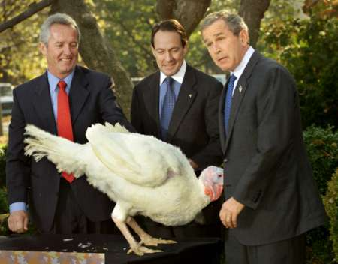
Our CEO got to meet President Bush

Slide 6
Discussion Topics
History of System Status Management / HPEMS
EMS Darwinism
Supply & Demand 101
Understanding Service Delivery Models
Dynamic / Hybrid Server Model Fundamentals
Matching Supply to Meet Demand
Conclusions / Q&A

Slide 7

History of System Status Management
Why was SSM / HPEMS created?
  Poor patient care outcomes
  Questionable reimbursement
  Open market competition problems
    Causing unique EMS economic conditions
  Mechanism for market exclusivity
  Product of early Lean / Six Sigma like thinking

Slide 8
History of System Status Management
Poor patient care outcomes…
  Advent of ALS in 1960’s not seeing expected clinical results from financial investments
  Importance of response times to patient care recognized
  Inconsistencies in service due to competitive nature
  EMS 9-1-1 service fragmentation KILLS people
  Poor EMS 9-1-1 system deign KILLS people
  Mismatched service delivery models

Slide 9

History of System Status Management
Questionable Reimbursement
  Underfunded by Federal, State and Private funding mechanisms – that depends…
  Funding problem or system design problem
    Its both!
  STRONGLY influenced by unique EMS economic conditions

Slide 10

The Problem of Open Market Competition in EMS
Unique EMS economic conditions
  Fixed market sizes (service areas) = relatively fixed revenue potential
    Market fluctuates based on age / size / socioeconomics / health of population served
    Uncontrollable / unpredictable external market influences sway demand for services (weather, flu, H1N1, etc.)
    Market size / demand for services NOT influenced by typical competitive market forces (quality / price / supply availability)

Slide 11
The Problem of Open Market Competition in EMS
Unique EMS economic conditions
  Competition drives down prices and costs up; therefore service quality, consistency, reliability and staying power suffer:
    Forces STUPID loss leader business practices (e.g. W/C)
    Forces STUPID patient care choices (e.g. Lack of EMD example)
    HIGHLY inefficient due to loss of economies of scale
    Drives independent EMS system evolution (EMS Darwinism – will discuss in a minute)

Slide 12
  The Problem of Open Market Competition in EMS Continued…
  Forces industry to seek relief through alternative reimbursement sources and business strategies
    Tax subsides
    Change revenue potential by increasing insurance funding
    Cut service quality
  Proprietary nature of open market competition makes one common “industry voice” IMPOSSIBLE
    No (or too many) regulation or standards bodies
    Root of poor reimbursement at State and Federal levels
      conflicting messages sent from various stakeholders with different agendas
    Need to learn from success of Fire Service / NFPA / IAFF / IAFC

Slide 13
Mechanism for Market Exclusivity
Jack Stout proved that due to the previously discussed unique EMS market conditions:
  EMS was no different than a Public Utility (Hence the PUM EMS System)
  Open market competition should be based on bidding for exclusive market areas with rights to all services (Emergency and Non-emergency)
Other exclusive EMS market models
  E.g. Failsafe franchises, etc.

Slide 14
SSM…A Product of Lean / Six Sigma Thinking
Jack Stout was about 30 years ahead of his time in his thinking and ideas
SSM IS manufacturing science / concepts applied to a service industry
Yields the most efficient, effective, reliable and reproducible desired end results (just like manufacturing desires)
SSM is not just about response times but all aspects of EMS operations and service delivery
SSM is the result of Lean / Six Sigma like projects that can be applied to most of EMS – so don’t reinvent the wheel

Slide 15
Discussion Topics
History of System Status Management / HPEMS
EMS Darwinism
Supply & Demand 101
Understanding Service Delivery Models
Dynamic / Hybrid Server Model Fundamentals
Matching Supply to Meet Demand
Conclusions / Q&A

Slide 16
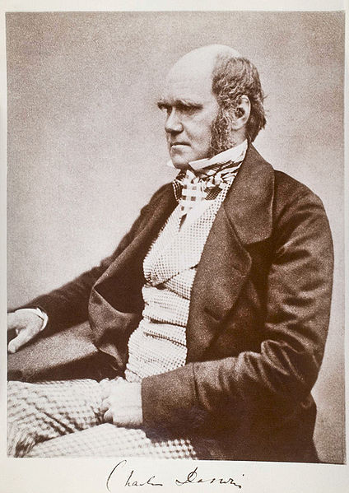
The Theory of EMS Darwinism
Darwinism / Evolutionary Theory
  Isolated environments produce similar species that evolve in different ways from each other
  Evolutionary adaptation to the environment occurs to ensure survival of the species
  EMS has “evolved” under these principles

Slide 17
The Theory of EMS Darwinism
EMS agencies are isolated from each other due to proprietary barriers created by varying system designs, ownership models and funding sources
Gives credence to the phrase “If you’ve seen one EMS system, you’ve seen one EMS system”
However, they are still of the same species…
Common operational denominators exist for every EMS system design type which provide the foundation for “Best Practices”
Acceptance of these “Best Practices” (Like SSM) depends on system design, necessity for change, culture and other factors

Slide 18
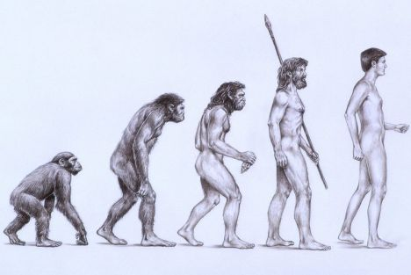
The Theory of EMS Darwinism
EMS Independent Evolutionary Variables
  System Designs
  Deployment Models
  Cultures / accepted behaviors (varies by geography)
  Nomenclatures (truck, unit, squad, bus, rig, ambulance)
  Patient care approaches / treatment modalities
  Provider look / feel
Should these things have evolved differently?
Impacts of these independent evolutions?

Slide 19
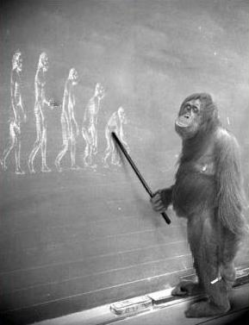
The Theory of
EMS Darwinism

Slide 20
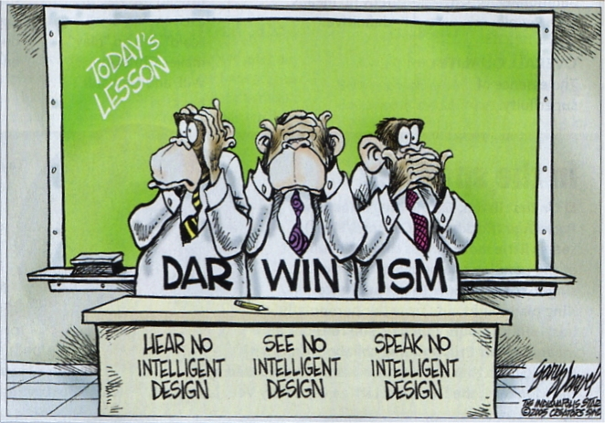
E M S

Slide 21
Economics 101
Understanding
Public Safety
Supply and Demand

Slide 22
Supply & Demand 101
Supply: Defined by Merriam-Webster as…
  Quantity or amount (as of a commodity) needed or available
  The act or process of filling a want or need (engaged in the supply of raw materials to industry)
  The quantities of goods or services offered for sale at a particular time or at one price

Slide 23
Supply & Demand 101
Demand: Defined by Merriam-Webster as…
  Willingness and ability to purchase a commodity or service
  The quantity of a commodity or service wanted at a specified price and time
  A seeking or state of being sought after, urgent need
  The requirement of work or of the expenditure of a resource

Slide 24

Supply & Demand 101
In EMS lingo…
Demand = Calls for Service
Supply = Deployment Methodology

Slide 25
Supply & Demand 101
Types Specific to Public Safety
  Static
    Showing little change
    Standing or fixed in one place
  Temporal
    Relating to time distinguished from space
    Relating to the sequence of time or to a particular time
    As defined by Merriam-Webster

Slide 26
Static Demand & Static Supply

Slide 27
Static Demand & Temporal Supply

Slide 28
Temporal Demand & Static Supply

Slide 29
Temporal Demand & Temporal Supply

Slide 30
Discussion Topics
History of System Status Management / HPEMS
EMS Darwinism
Supply & Demand 101
Understanding Service Delivery Models
Dynamic / Hybrid Server Model Fundamentals
Matching Supply to Meet Demand
Conclusions / Q&A

Slide 31
Understanding Service Delivery Models
Definition
The mechanisms, processes, protocols and procedures used to deliver a desired product or service to the end consumer

Slide 32
Understanding Service Delivery Models
Definitions of Various Service Delivery Models
EMS Specific Service Delivery Models
  Fixed server model
  Dynamic server model
  Hybrid server model
Fixed Location / Fixed Staffing | Fixed Location / Dynamic Staffing
Dynamic Location / Fixed Staffing | Dynamic Location / Dynamic Staffing

Slide 33
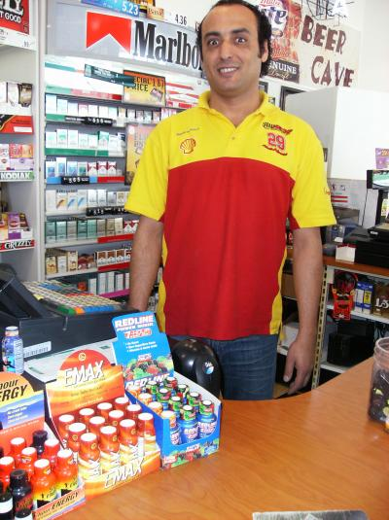
Understanding Service Delivery Models
Fixed Location / Fixed Staffing
  Server location doesn’t change
  Staffing doesn’t change
  Examples:
    Most smaller store or department checkout counters
    Fire service

Slide 34

Understanding Service Delivery Models
Fixed Location / Dynamic Staffing
  Server location doesn’t change
  Staffing changes based on demand for services
  Examples:
    Large chain store checkout counters

Slide 35


Understanding Service Delivery Models
Dynamic Location / Fixed Staffing
  Server location changes based on demand for service
  Staffing doesn’t change
  Examples:
    Snap-on tool truck

Slide 36

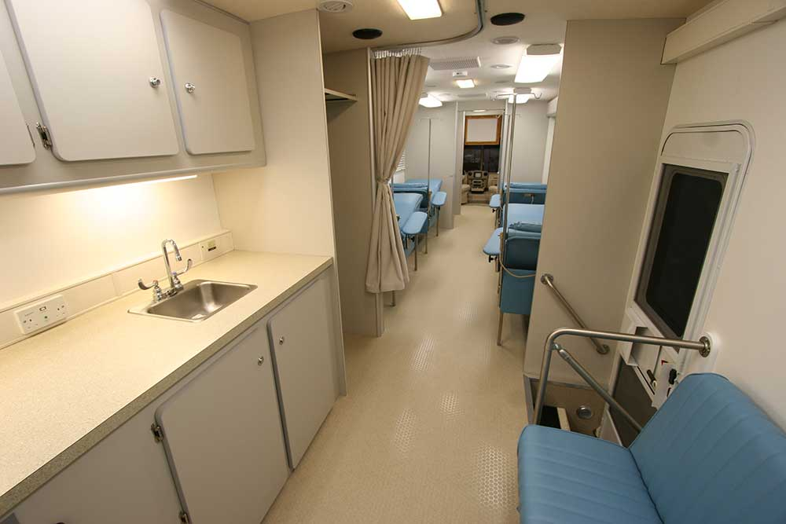
Understanding Service Delivery Models
Dynamic Location / Dynamic Staffing
  Server location changes based on demand for service
  Staffing changes based on demand for service
  Examples:
    Blood Mobile
    Jack Stout’s genius - SSM

Slide 37
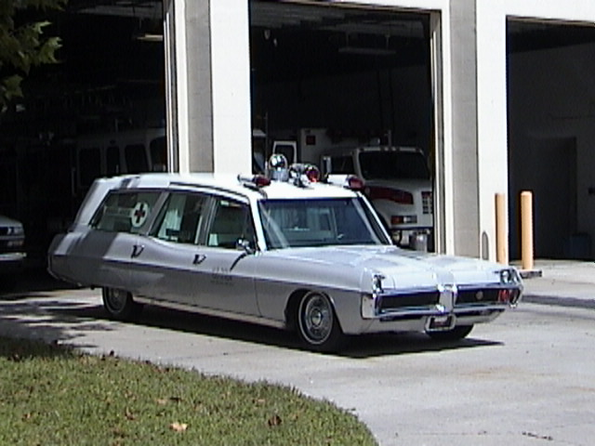
EMS Specific Service Delivery Models
Fixed Server Model
  Staffing fixed 24 x 7
    Number of units are the same no matter the hour or day of the week
  Server locations fixed 24 x 7
    Station based, resources serve (respond) from a fixed point
    Geographically placed stations designed to respond within a certain timeframe (based on ISO standards of coverage)

Slide 38
EMS Specific Service Delivery Models
Fixed Server Model
  Single dimension design without much depth
    Serve first customer well
    Second customer not so well
    Third or greater customer – forget about it
  Well designed for the Fire Service NOT EMS
    Probability of geographically proximal simultaneous fire events VERY low – Fixed server to Fixed demand concept
    Probability of geographically proximal simultaneous EMS events VERY high – Fixed server to Dynamic demand concept

Slide 39
EMS Specific Service Delivery Models
Fixed Server Model
  Pros
    Responds to first call REALLY well
    Suburban / rural coverage typically better
    Employees like it
  Cons
    Inconsistent, unreliable service to simultaneous geographically proximal requests
    VERY expensive to maintain for medium and larger service areas
    Most probable to require tax subsidies (medium to large systems)

Slide 40

EMS Specific Service Delivery Models
Dynamic Server Model
  Dynamic staffing that varies 24 x 7
    Number of units vary by hour of day and day of the week based on meeting predicted service demands at a desired service reliability standard (e.g. 8 minute response time 90% of the time)
  Dynamic server locations 24 x 7
    Units deploy dynamically based on predicted geospatial service demands by hour of day and day of week

Slide 41
EMS Specific Service Delivery Models
Dynamic Server Model
  Multi-dimension design with great depth
    Serve first customer well
    Second customer served well
    Third or greater customer – served well 90% of the time
  Well Designed for Urban EMS
    Most people live in predictable patterns of behavior which change by hour and day
    Dynamic server models deploy where the population is most likely to be for a given hour and day

Slide 42
EMS Specific Service Delivery Models
Dynamic Server Model
  Pros
    Services majority of calls REALLY well
    The most economically efficient model especially when coupled with exclusive market rights
    Adjusts to keep pace with changes in demand
    Most probable to operate without tax subsides
  Cons
    Employees typically dislike it (although can be managed)
    Suburban / rural coverage not as good as fixed model
    Higher vehicle maintenance requirements and fuel costs

Slide 43
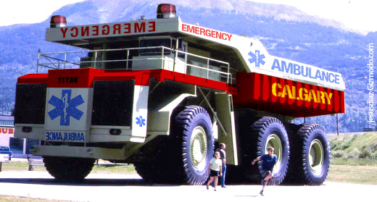
EMS Specific Service Delivery Models
Hybrid Server Model
  Combination of dynamic and fixed staffing
    Used in service areas with mixed geospatial and temporal demand needs - urban / suburban / rural service needs
    Dynamic staffing in urban areas, fixed staffing in suburban / rural areas
  Dynamic and fixed server locations
    Units deploy dynamically based on predicted geospatial service demands by hour of day and day of week and also in fixed locations for suburban / rural coverage

Slide 44
EMS Specific Service Delivery Models
Hybrid Server Model
  Multi-dimension design with superior depth
  Best of both worlds
    Fixed coverage for rural / suburban service needs (which are harder to predict)
    Dynamic coverage for urban areas
  Melding of economic efficiency with higher cost demands of fixed deployment needs

Slide 45
EMS Specific Service Delivery Models
Hybrid Server Model
  Pros
    Services majority of calls REALLY well
    Economic tradeoffs - efficiency helps defray costlier coverage needs
    Adjusts to keep pace with changes in demand
    Employees like if in fixed portion of the model
    May be able to operate without tax subsides
  Cons
    Employees dislike if in dynamic portion of the model
    Higher vehicle maintenance requirements and fuel costs
    Tax subsides may be needed

Slide 46

EMS Specific Service Delivery Models
What is System Status Management?
The art and science used to determine service staffing and server location requirements behind Dynamic and Hybrid EMS service delivery models

Slide 47
Discussion Topics
History of System Status Management / HPEMS
EMS Darwinism
Supply & Demand 101
Understanding Service Delivery Models
Dynamic / Hybrid Server Model Fundamentals
Matching Supply to Meet Demand
Conclusions / Q&A

Slide 48
Dynamic / Hybrid Server Model Fundamentals
Basic Premises
  Match supply with demand using two variables
    Temporally – Number of resources needed by hour of day and day of week in order to meet a certain service reliability standard – a.k.a. Peak-load staffing
    Geospatially – Where resources will serve from by hour of day and day of week in order to meet a certain service reliability standard – a.k.a. Posting Plan

Slide 49
Dynamic / Hybrid Server Model Fundamentals
Basic Premises
  Production model theory taken from manufacturing
    Lean / 6 Sigma like design
    Product = Quality Unit Hour
    Service = Medicine provided by the QUH
    All products provide a service concept
      Wal-Mart vs. Bose story

Slide 50
Dynamic / Hybrid Server Model Fundamentals
Basic Premises
  EMS Success Triad…a balancing of
    Patient care
    Employee well-being
    Financial stability / success
Success
Triad
Patient Care
Economic Stability
Employee Wellbeing

Slide 51
Discussion Topics
History of System Status Management / HPEMS
EMS Darwinism
Supply & Demand 101
Understanding Service Delivery Models
Dynamic / Hybrid Server Model Fundamentals
Matching Supply to Meet Demand
Conclusions / Q&A

Slide 52
Matching Supply & Demand
Temporal demand prediction models
Temporal demand matching
Geospatial demand matching

Slide 53
Matching Supply & Demand: Temporal
Temporal demand prediction models
  Used to determine coverage at a certain level of service reliability – NOT a predictor of call volume
  20 weeks typically used but 10B/10F also popular
  168 hour analysis (each hour of a week)
  UCLA study of mathematical models
  Drives dynamic staffing plans / schedules

Slide 54
Matching Supply & Demand: Temporal
Temporal demand prediction models
  Various mathematical approaches used:
    Average Peak – Yields roughly the 90% percentile of demand, or staffing to a 1:10 week event
      Excel Formula =(Max(1st 10 week period) + Max (2nd 10 week period))/2
    2 Standard Deviations Above Mean – Yields roughly the 95% percentile of demand, or staffing to a 0.5:10 week event
      Excel Formula =(stdev(20 week period)*2)+average(20 week period)
    Percentile Ranking – Yields the percentile defined
      Excel Formula =Percentile(20 week period, 0.9) for 90%

Slide 55
Matching Supply & Demand: Temporal
Temporal demand prediction models
  Advanced variables for accurate results
    Data validity – CAD data must be accurate in order to yield accurate results
    Time on task / demand consumption – Has significant impact to service reliability as longer task times require more unit hours
    Demand off-setting – A method used to adjust CAD data to customer service requirement vs. serviced level (P/U Requested versus Promised concept versus actual performance)
    Demand modeling – Various techniques to adjust for CAD technology or procedural shortfalls that negatively impact data

Slide 56
Matching Supply & Demand: Temporal
Temporal demand prediction models
  No OTS products available to predict demand or perform advanced demand analysis
    Very complex issue typically requiring custom solutions
    Some CADs have canned reports – be VERY weary!
    Consultant / software solutions provider usually required for accurate demand modeling or on-staff software engineer who also understands EMS

Slide 57
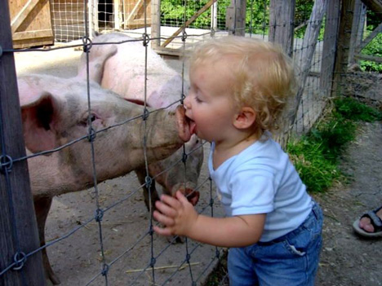
Matching Supply & Demand: Temporal
Temporal demand prediction models
  Lessons learned (what not to do)

Slide 58
Matching Supply & Demand: Temporal
Temporal demand prediction models
  Lessons learned (what not to do)
    Have one schedule in place for many years
    Shift-bidding same schedule over and over
    No recent demand analysis or bad science / data used
    Shifts built to employee need and not demand need which is a patient care issue
    Schedule mismatching to actual demand

Slide 59
Matching Supply & Demand: Temporal
Temporal demand matching
  Process of matching supply with demand by building a staffing schedule to meet predicted service requirements from demand analysis
  Tricky and complex dance to balance the EMS Success Triad (Patient Care / Employee Well-being / Financial Stability)
  Wars have been fought over this issue of SSM

Slide 60
Matching Supply & Demand: Temporal
Temporal demand matching
  Various approaches to achieve desired end results
    Colored pencils, graph paper, lots of patience & time
    Excel modeling of schedules to demand
    BEST PRACTICE – Zoll Resource Planner
      An OTS solution
      Worth its weight in gold!
      Need advanced training beyond what comes with solution to truly maximize benefits

Slide 61
Matching Supply & Demand: Temporal
Temporal demand matching
  Advanced techniques & “the art”
    Understanding SOS/EOS and other lost unit hour impacts on coverage levels
    The “art” of SSM comes into play when figuring out unit hour supply chain needs beyond those of pure demand especially in untested waters (e.g. RFP time)
      Numerous variables that may need to be accounted for
  Readjust often to meet changing system needs

Slide 62
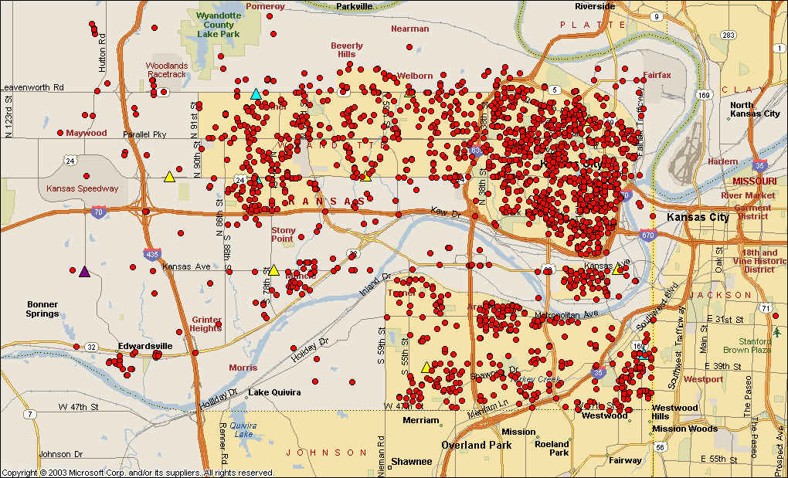
Geospatial Demand Matching

Slide 63
Matching Supply & Demand: Geospatial
Geospatial demand matching
  Most commonly misunderstood SSM concept
    Most posting plans are built using the wrong approaches
  Most commonly underutilized SSM tool
    Significant benefits come to those who learn to use this concept properly and then actually implement it
  Goal is to match resource server locations to human behavior patterns as they change over space and time
    Based on user patterns mined from CAD data

Slide 64
Matching Supply & Demand: Geospatial
Geospatial demand matching
  General design concepts
    Plot proper calls on a map
    Determine server points (posts, signal points, etc)
    Determine desired level of service reliability and response time
    Determine Time/Distance Ratio or road network impedance
    Determine travel time / service areas from server points
    Build a posting plan to match resources with demand using the biggest bang for the buck approach (most good for most people with least number of resources)

Slide 65
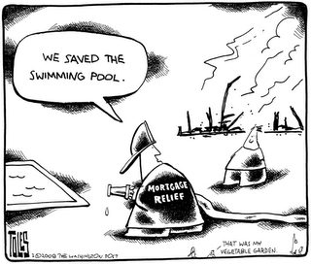
Matching Supply & Demand: Geospatial
Geospatial demand matching
  Lessons learned (what not to do)

Slide 66
Matching Supply & Demand: Geospatial
Geospatial demand matching
  Lessons learned (what not to do)
    Having only one System Status Plan / server plan
    Building your plan based on geographic coverage not demand
    Posting geopolitically wastes precious resources
    Using all calls in your demand map versus using only the strictest response time standard to model from
    Assuming your TDR is static (it changes by hour and day)
    Never changing your System Status Plan
    Not using posting priorities / location prioritization

Slide 67
Matching Supply & Demand: Geospatial
Geospatial demand matching
  OTS tools for building excellent server plans
    Excel spreadsheets
    GIS Tools (ESRI / MS MapPoint)
    MARVLIS
    SIREN
    Deccan
    Active

Slide 68
Matching Supply & Demand: Geospatial
Geospatial demand matching
  Traditional management of server plans
    Standard old style posting pyramid approach
    Entered into CAD for real-time management
    Old concept “Follow the Damn Plan”
    Post moves made to stay in plan don’t always make sense

Slide 69
Matching Supply & Demand: Geospatial
Geospatial demand matching
  New approach to geospatial deployment
    Computer / data driven decision support for real-time deployment
    No more SSP - posting based on system needs
    Much more dynamic allowing for new variable applications
    Workload management enabled
    Post moves decreased significantly
    Better response times
    Improved employee morale

Slide 70
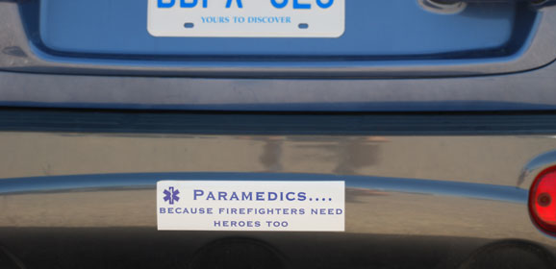
We wrap up on a humorous note…

Slide 71
Some Conclusions & Walk-away Points
Response times matter
Differentiate yourself in the market with quality and don’t give away the farm
Learn from other EMS sub-species (best practices)
Demand analysis = prediction of service reliability NOT call volume
Use temporal and geospatial demand often to adjust supply to demand
Movement towards live SSM with decision support

Slide 72
Question & Answer Session
Speaker Contact Information:
REMSA: jwashko@remsa-cf.com / 775-858-5700
W&A: jw@washkoassoc.com / 775-453-4SSM
Download this Presentation at:
www.washkoassoc.com

