Slide 1
Best Practices in
Emergency Medical Services
Presented By:
Jonathan D. Washko, NREMT-P, BS-EMSA
Executive Director for Operations Services – REMSA
President – Washko & Associates, LLC
OAMTA Annual Conference - June 12, 2009
Sponsored by Community Care Ambulance Network – Ashtabula, OH

Slide 2

Best Practices in EMS Overview
What is a best practice
Why EMS needs best practices
The theory of EMS Darwinism
The economy and best practices
Best practices dissected & discussed
Wrap up / Q&A

Slide 3

Presenter Background
Involved in Public Safety for 23 years
BS Degree in EMS Admin with focused studies on EMS system design and adult education
Studied under Jack Stout, father of SSM/HPEMS
Held paramedic to executive level positions with small, medium and large sized companies
Have worked in / for every type of EMS system design
10 Years with AMR as corporate executive and systems troubleshooter
Co-founder / co-developer of FirstWatch
19 years EMS system design consulting experience
Currently Executive Director with REMSA, Reno, NV

Slide 4


REMSA’s Military Support
REMSA was a 2008 Recipient of the Freedom Award
Currently have 5 Medics on active duty in Afghanistan
Support our troops in various ways
  Keep REMSA Salary whole while on Active Duty
  Provide 100% Benefits coverage while on Active Duty Including Family
  Send along laptops, software & other needed items
  Send monthly care packages to our employees
Notes:
Jon’s Slide

Slide 5

What is a “Best Practice”
Wikipedia defines it as…
A Best practice is the belief that there is a technique, method, process, activity, incentive or reward that is more effective at delivering a particular outcome than any other technique, method, process, etc. The idea is that with proper processes, checks, and testing, a desired outcome can be delivered with fewer problems and unforeseen complications. Best practices can also be defined as the most efficient (least amount of effort) and effective (best results) way of accomplishing a task, based on repeatable procedures that have proven themselves over time for large numbers of people.

Slide 6
Why EMS Needs “Best Practices”
The Theory of EMS Darwinism
Service delivery model variations / inconsistencies
Lack of commonly accepted operational standards (like NFPA for Fire Service)
Mix of public / private / government ownership
Mix of for profit / non-profit models
Lack of standardized managerial education platform
Industry has attempted to bridge educational gap with limited success
Success lies in sharing clinical best practices but not operational ones

Slide 7
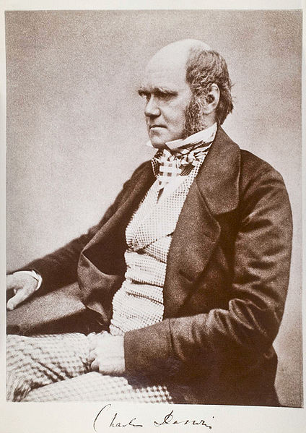
The Theory of EMS Darwinism
Darwinism / Evolutionary Theory
  Isolated environments produce similar species that evolve in different ways from each other
  Evolutionary adaptation to the environment occurs to ensure survival of the species
  EMS has “evolved” under these principles

Slide 8
The Theory of EMS Darwinism
EMS agencies are isolated from each other due to proprietary barriers created by varying system designs, ownership models and funding sources
Gives credence to the phrase “If you’ve seen one EMS system, you’ve seen one EMS system”
However, they are still of the same species…
Common operational denominators exist for every EMS system which provide the foundation for “Best Practices”
Acceptance of these “Best Practices” depends on your system design, necessity for change, culture and other factors

Slide 9
The Theory of EMS Darwinism

Slide 10
My industry experience has been…
Necessity may be the mother invention however…
…it also drives acceptance of the previously unacceptable

Slide 11
Current / Future Economic and Demographic Conditions
If there ever has been a time where necessity will drive innovation, acceptance of the unacceptable and the merging of separately evolved species into one, it is now!
Shrinking public funding mechanisms, uncertain healthcare dollars and rising unemployment in the face of a large aging boomer generation will force industry innovation and change
Funding / service level / employment compensation tradeoff’s or service delivery model design changes…you decide (as may the current presidential administration)

Slide 12
Best Practices in EMS - Disclaimer
Best practices mentioned in this presentation are based on my personal exposure / experience with numerous EMS systems across the US, Canada and other European nations
I know many other best practices beyond those mentioned in the presentation exist, I have just not had the privilege of seeing or learning about all of them as of yet
If you know of a best practice and would like to share it please feel free to do so anytime during the presentation

Slide 13

Best Practices in EMS
Deployment Science
Operations
Supply / Logistics
Fleet maintenance
Human resources
Training / education
Quality Improvement
Billing / Finance
Communications
EMS System Designs
EMS Response to Pandemic

Slide 14

Deployment Science
Best Practices in EMS

Slide 15
Best Practices in EMS
Deployment Science
Setting service reliability standards and then meeting them for emergency and non-emergency service
  e.g. Life threatening emergencies responded to within 8 minutes 90% of the time
Measure response times ACCURATELY (no smoke and mirrors)
  Fractile measurement approach not average
  Call received in 9-1-1 center to on scene

Slide 16
Best Practices in EMS
Deployment Science
Using deployment methodologies that match supply and demand both temporally and geospatially
  Production Model EMS / SSM / Peak Load Staffing
  Station move-ups based on demand not geography
Realize that deployment methodology and response time service reliability are just as important (if not more) as the medicine we provide
  Life-saving treatment is worthless if it is not provided in time
  Deployment methodology drives labor costs up or down which has a direct effect on the quality of medicine we can afford to provide given the current reimbursement mechanisms

Slide 17
Best Practices in EMS
Deployment Science
Technological edge
  Live decision support tools for making resource deployment decisions in real-time
    MARVLIS
    SIREN
    DECCAN
    CAD vendor specific features
  Balanced matching of service demand needs with human needs
    Zoll Resource Planner
  In-vehicle smart routing systems that use live or historical road network data to adjust routes and candidate rankings

Slide 18
Ambulance Operations
Best Practices in EMS

Slide 19
Best Practices in EMS
Operations
Vehicle design conducive to long-term, in ambulance shifts
  DVD / entertainment systems
  Larger front cabs to allow for reclining in front of unit
Field supervisors capable of on-site / on demand lost unit hour mitigation
  Solve a variety of issues that would take an ambulance out of service or cause service inefficiency
  Resupply of medical supplies, fixing of vehicle problems, availability of backup equipment, bariatric stretcher delivery

Slide 20
Best Practices in EMS
Operations
Managerial Front
  Recognition of “generational differences” and how to overcome them
  Moving away from performance based compensation programs
  Recognition that physical separation of employees from management leads to unions and/or poor employee / employer communications
  Recognition that the best clinicians don’t necessarily make the best organizational leaders
  Recognition that our leaders and managers need training in leading and managing

Slide 21
Best Practices in EMS
Operations
Recognition that 24 hour shifts in busy urban EMS systems are not conducive for safety or quality patient care
Recognition that EMS is a 24x7 business and should be managed as such
  Lessons from other public safety disciplines
    FD / PD management systems
Integration of ICS into daily routines to improve EMS familiarity

Slide 22
Best Practices in EMS
Operations
Technological Edge
  Online scheduling systems
    Allow for online management of schedule, shift trades, PTO, OT pickup, etc.
    Integration into CAD or other decision support tools
  Employee communications
    Twitter / Facebook VERY effective tool if managed and administrated properly
    Many ePCR / eScheduling / time and attendance systems allow for broadcast and individual messaging
    Email systems may or may not be effective
    Reader boards with “Flash & Pizzazz”
    Office Live – Sharepoint Server

Slide 23

Supply & Logistics
Best Practices in EMS

Slide 24
Best Practices in EMS
Supply & Logistics
Centralized deployment facilities / hubs
EMS providers not responsible for checking supply levels, wash vehicles or maintaining vehicles
Fleet-wide standardization of ambulance design
Assembly line style resupply systems “speed loaders”
  Streamlined restocking processes
  Improves supply reliability
  Improves resupply efficiency

Slide 25
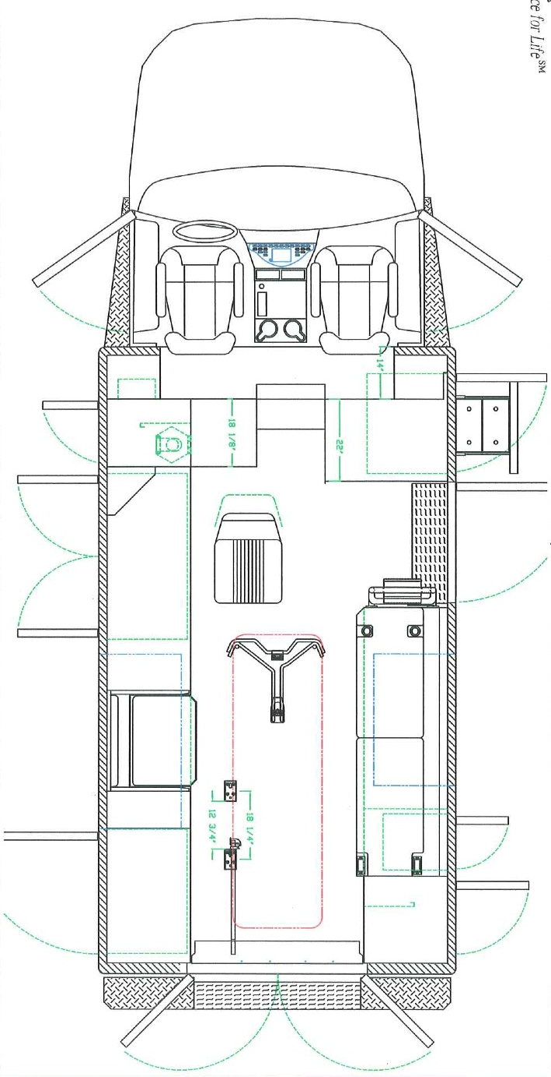
Service Points Workflow
GFGGS
SERVICE POINTS WORKFLOW
“Once Around The Ambulance”
Notes:
Val’s Slide

Slide 26
Best Practices in EMS
Supply & Logistics
Technological Edge
  Just in time ordering systems that minimize the need for warehousing of vast amounts of supplies
  Online inventory and ordering systems provided by vendors
  Bar coding / RF ID systems
  Electronic check-in/out equipment accountability systems

Slide 27
Fleet Maintenance
Best Practices in EMS

Slide 28
Best Practices in EMS
Fleet Maintenance
Preventative maintenance (PM) programs that mimic the airline industry
“Green” initiatives including solar charging systems, bio-fuels, lighter vehicles, etc.
Bridging the Ford 6.0 liter issues
  Refurbishing 7.3 liter chassis
  Class action law suit
  Gas / diesel

Slide 29
Best Practices in EMS
Fleet Maintenance
Technological Edge
  Onboard “black box” driving computers that provide G-force feedback and record/transmit everything wirelessly (Road-Safety)
  Cameras that capture significant events (DriveCam)
  Wireless in-vehicle routers that provide internet access via the cellular data networks (InMotion)
  Fleet maintenance tracking software that allows for part failure analysis that is integrated into the PM system

Slide 30
Human Resources
Best Practices in EMS

Slide 31
Best Practices in EMS
Human Resource Management
Proactive headcount management practices
Streamlined policies & procedures directly linked with accreditation standards (C.A.A.S. / C.A.M.T.S. / A.C.E.)
Academy style orientation programs for new hire employees
Internal EMS education for EMT & Paramedic certifications with working scholarships
  Paid PD/FD style educational academy
Policies on social networking impacts on the workplace

Slide 32
Best Practices in EMS
Human Resource Management
Technological Edge
  Online employee tools for benefit management and administration
  Online policies and procedures access
  Paperless employee files with secure access available to management 24x7
  Streamlined business systems that talk to each other
    HR Systems <-> eScheduling <-> Pay Roll <-> CAD <-> ePCR <-> eCertification Systems

Slide 33

Training / Education
Best Practices in EMS

Slide 34
Best Practices in EMS
Training / Education
Online systems for off-site training
  Web based meetings / presentation systems
    WebEx, GoToMeeting, NEFSIS, etc.
  On demand content provision (proprietary or purchased)
  Online testing / certification systems
Simulation Labs
  Sophisticated simulators / manikins
  Lab designed just for simulation training scenarios
Real-time on-duty scenario training / testing

Slide 35
Best Practices in EMS
Training / Education
Using training and education programs to supplement your system’s revenue and offset training overhead costs
  AHA training
  Private industry training
  Ancillary healthcare services training
  Government / military
Portable training programs with portable simulation labs
  Increase training reach to remote markets
  Open up new opportunities
  Rural services

Slide 36
Quality Improvement
Best Practices in EMS

Slide 37
Best Practices In EMS
Quality Improvement
Using ePCR systems to improve QI efficiency, effectiveness and portability
Using advanced automated QI systems that enable 100% auditing of charts against clinical documentation and protocol standards
Adopting QI workflows that improve employee communication, feedback loops and remediation for improved behavior modification

Slide 38
Billing / Finance
Best Practices in EMS

Slide 39
Best Practices in EMS
Billing / Finance
Paperless ePCR systems making A/R a much more efficient and effective process
Granular financial statements that group each service line and operational individually for improved decision making abilities
A/R tracking by customer with monthly financial trigger processes to identify payer problems

Slide 40
Best Practices in EMS
Billing / Finance
Lean business processes that measure productivity and performance
Internal Federal Compliance auditing by an independent agency
Quality based reimbursement initiatives at the Federal level
Online payment and account management options

Slide 41

Communications
Best Practices in EMS

Slide 42
Best Practices in EMS Communications
“Situational awareness” / “decision support”
EMD System
  Call classification for resource triage (priority based dispatching processes)
  Pre-arrival instructions
  Pandemic / CBRN screening system
Live data surveillance systems
  Syndromic / bio-terrorism
  Operational
  Sentinel event

Slide 43
Best Practices in EMS Communications
CAD systems
  AVL / GPS integrated
  Dynamic road network speed algorithms for routing and candidate ranking
  Real-time demand surveillance
  Real-time deployment decision support systems
  Live off-site redundancy & backup systems
Phone / Radio systems
  Phase II wireless compliance
  IP based communications systems

Slide 44
EMS System Design
Best Practices in EMS

Slide 45
Best Practices in EMS
EMS System Designs
System designs must comprehend EMS economics to survive
  Not effected by typical elasticity of supply & demand
    Population size, age, socio-economics & other demographics
  Pricing / quantity does not drive increases or decreases in overall service demands (volume)
  Free market competition drives up costs / drives down quality
  System fragmentation decreases economies of scale, significantly increases costs of operations and typically provides for poor patient care (response times)

Slide 46
Best Practices in EMS
EMS System Designs
No EMS system design is perfect
“Successful” ones include the following features:
  Limited or zero local tax subsidy
  Service accountability through performance guarantees and standards
  Ability to replace the provider for performance failures
  Closed market with sole source provider performing emergency and non-emergency services (most economically efficient model)
  Rates and performance controlled through publically accountable entities
  Balance patient care, employee wellbeing and financial responsibility

Slide 47
Best Practices in EMS
EMS System Designs
Recognition that the deployment model used within an EMS system has a direct correlation on system costs and patient care effectiveness and outcomes
  Demand driven systems provide considerably better service reliability to a much larger patient population
  Fixed geographic based systems provide good service to the first patient, but not necessarily the second, third and so on
  Economics and politics are typical determiners of EMS system design type until the EMS system kills the wrong person or costs too much money

Slide 48

Pandemic Response
Best Practices in EMS

Slide 49
Best Practices in EMS
Pandemic Response (H1N1)
WHO declared a worldwide pandemic level 6 this week (actually well over due)
While H1N1 (Swine Flu) has been very mild, there is heightened concern by health officials that it could become more virulent this fall (mortality <1% currently)
H5N1 (Avian Flu) is happening in the middle east but no human to human transmission YET (40% – 50% mortality when it is contracted)

Slide 50
Best Practices in EMS
Pandemic Response (H1N1)
EARLY screening / surveillance during the 9-1-1 call
  NAED SRI Screening / Card 36 Pandemic Flu
Based on findings, first responders (FD/PD) and EMS personnel “suit up” PRIOR to entry / patient contact
  Protect your assets (lessons learned from SARS)
  Reverse isolation of patient
Protocols / processes for system overload, denial of service or altered response configurations
  6-1-1 Information lines / 9-1-1 call center demand shifting
  Public & public safety information systems imperative

Slide 51
Best Practices in EMS
Pandemic Response (H1N1)
Consider supply needs PRIOR to the incident
  Isolation supply caches
  Cleaning / decontamination supply caches
  Enough for everyone (FD/PD/EMS/Family)?
ICS system / Command & Control may rest with the Health Department
  Poor experience with ICS / EMS / Public Safety
  Public health focus on the epidemiology / medicine / treatments
  Communication channels may be limited or non-existent

Slide 52
Best Practices in EMS
Pandemic Response (H1N1)
Consider personnel needs (different then disaster)
  Shelter in place requirements / isolation impact
  Logistical needs of your personnel
Consider other infrastructure support needs
  All items needed to provide service
  AMFYOYO – remember this will be large scale, wide spread and concurrent events nation / world wide
Communicate / Communicate / Communicate
  The public
  Employees & their families
  Public safety agencies
  Health Department / CDC / WHO

Slide 53
Best Practices in EMS
Questions & Answers
Share Your Best Practices…
Copies of this presentation will be available at:
www.washkoassoc.com

