Slide 1
How You Know When You Have Achieved High Performance EMS
Jonathan D. Washko, BS-EMSA, NREMT-P, EMD
Consulting Director – REMSA
President – Washko & Associates, LLC

Slide 2
Presentation Overview
Why Should You Care
Define HPEMS
Building The Foundation - Data
Key Performance Indicators
Trending
Benchmarking
Leveraging Technology for Success
Achievement of HPEMS

Slide 3
About the Presenter
Involved in Public Safety for 25 years
BS Degree in EMS Admin with focused studies on EMS system design and adult education
Studied under Jack Stout, father of SSM/HPEMS
Held Paramedic to Executive level positions with small, medium and large sized companies
Have worked in / for every type of EMS system design
10 Years with AMR as corporate executive and systems troubleshooter
Co-founder / co-developer of FirstWatch
20 years EMS system design consulting experience
Have experienced the good and bad of >100 EMS agencies around the globe
Currently Director with REMSA, Reno, NV

Slide 4
About REMSA/SEMSA
Based in Reno, NV
  Subsidiary sites in Susanville & Merced, CA
A Public Utility Model EMS System
Services Offered
  Ground ALS
  Rotor Wing
  Wheelchair
  Special Event
  Training Academy
Approximately 50,000 calls annually
Triple Accredited agency
  ACE
  CAAS
  CAMTS
No Tax Subsidy

Slide 5
REMSA’s Military Support
REMSA was a 2008 Recipient of the Freedom Award
Currently have 5 Medics that just recently returned from active duty in Afghanistan
Support our troops in various ways
  Keep REMSA Salary whole while on Active Duty
  Provide 100% Benefits coverage while on Active Duty Including Family
  Send along laptops, software & other needed items
  Send monthly care packages to our employees

Slide 6
Achieving HPEMS:
Why Should You Care
If you desire…
Quality
Efficiency
Effectiveness
Reliability
Accountability
Sustainability
Profitability
…then you want to achieve HPEMS

Slide 7
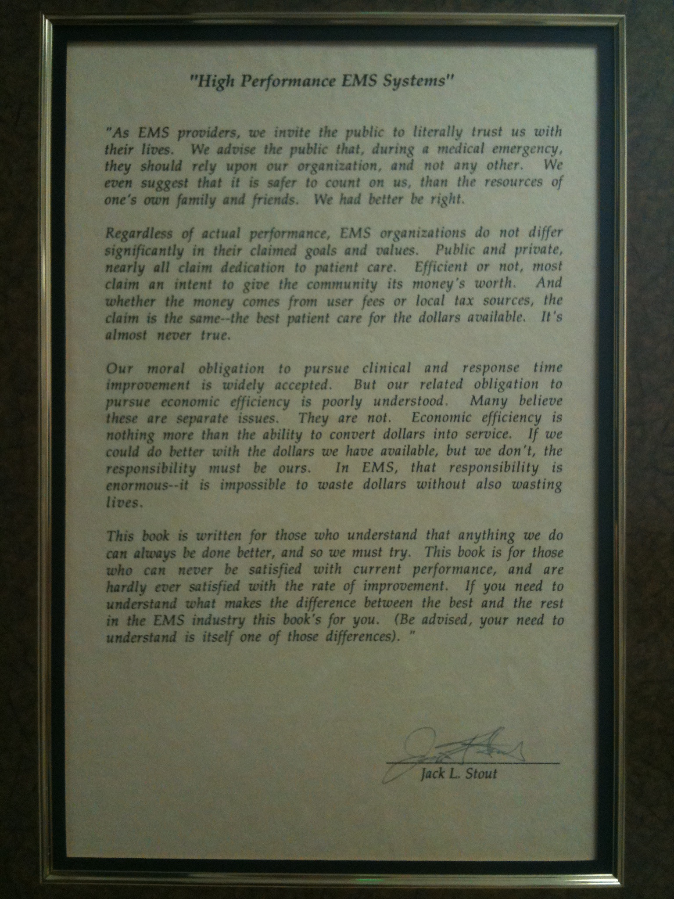
“High Performance EMS Systems”
A preface written by Jack L. Stout
(Father of System Status Management and the Public Utility Model EMS Concept)
Included in the American Ambulance Association’s Community Guide to Ensure High-Performance Emergency Ambulance Service

Slide 8
Achieving HPEMS:
“As EMS providers, we invite the public to literally trust us with their lives. We advise the public that, during a medical emergency, they should rely upon our organization, and not any other. We even suggest that it is safer to count on us, than the resources of one’s own family and friends. We had better be right.
Regardless of actual performance, EMS organizations do not differ significantly in their claimed goals and values. Public and private, nearly all claim dedication to patient care. Efficient or not, most claim an intent to give the community its money’s worth. And whether the money comes from user fees or local tax sources, the claim is the same—the best patient care for the dollars available. It’s almost never true.
Our moral obligation to pursue clinical and response time improvement is widely accepted. But our related obligation to pursue economic efficiency is poorly understood. Many believe these are separate issues. They are not. Economic efficiency is nothing more than the ability to convert dollars into service. If we could do better with the dollars we have available, but we don’t, the responsibility must be ours. In EMS, that responsibility is enormous—it is impossible to waste dollars without also wasting lives.”
Jack L. Stout

Slide 9
HPEMS Success Triad
Constant Balancing of:
  Patient Care
    Response Times
    Clinical & Service Quality
    Customer Service
  Economic Stability
    Profitability
    System Stability
  Employee Wellbeing
    Morale
    Retention
    Health, Safety & Welfare
The
EMS
Success
Triad
Patient Care
Economic Stability
Employee Wellbeing

Slide 10
Achieving HPEMS: Definition

Slide 11



So What is HPEMS?
The ability to convert dollars into superior service with as little waste as possible via a balanced modus operandi

Slide 12
Achieving HPEMS: The Foundation
Data…Data…Data
  “If you can’t measure it, you can’t manage it”
  Klark Staffan
  REMSA VP

Slide 13
Achieving HPEMS: The Foundation
Data….Data…Data
  Not just any data, but ACCURATE data
  The basic building blocks that all of the concepts used in HPEMS are founded on
  Bad data is like bad concrete, you can build with it but it will crumble under a load
  Your business processes (or lack there of) drive how data is collected and therefore yield consistent or inconsistent data as end results of these processes

Slide 14
Achieving HPEMS: The Foundation
Common Examples of Bad Data Processes in HPEMS
  NET requested P/U time vs. promised time
  Lack of auditable data reconciliation and error correction process
    Time stamp corrections
    Geocoding failures
    Response zone errors
  Changing data to meet measurement criteria vs. properly designed reporting systems
    Response times
  Accurate measurement of LDT calls
  Ability to track various types of Unit Hours
    Scheduled, Actual, Lost & Effective

Slide 15
Achieving HPEMS: The Foundation
Common Examples of Bad Data Processes In HPEMS Continued…
  Inability to access / report on data
    Bad CAD or Technology
    Un/consciously Incompetent
  General lack of data centric focus by organization
  Lack of personnel with necessary skill sets
  Misunderstanding of HPEMS theory and practices

Slide 16
Achieving HPEMS: The Foundation
Why is Data Accuracy Important?
  It’s the basis for your Deployment Plan
  Temporal Demand Analysis => Schedule
    Primary Efficiency Platform for HPEMS
    Yields right number of resources at the right time based on consumer demands and service reliability goals
  Geographic Demand Analysis => Post Plan
    Primary Effectiveness Platform for HPEMS
    Yields proper placement of resources at the right time based on consumer demands and service reliability goals

Slide 17
Achieving HPEMS: The Foundation
Importance of Data Accuracy Continued….
  Foundation for development of Key Performance Indicators (KPIs)
  Foundation for internal and external benchmarking and trending
  Foundation for HPEMS budgeting
  Foundation for pro forma modeling in RFPs and agency acquisitions
  Mechanism to ensure highest ROI if selling your organization

Slide 18
Achieving HPEMS:
Key Performance Indicators KPIs
Define KPIs
Types / Classes of KPIs
Design elements
Tying KPI’s to strategic goals
Examples of common HPEMS KPIs
KPIs role in achieving HPEMS

Slide 19
Key Performance Indicators (KPIs)
Definition
“A key performance indicator (KPI) is a measure of performance. Such measures are commonly used to help an organization define and evaluate how successful it is, typically in terms of making progress towards its long-term organizational goals. KPIs can be specified by answering the question, "What is really important to different stakeholders?" KPIs may be monitored using Business Intelligence techniques to assess the present state of the business and to assist in prescribing a course of action. “
Source: Wikipedia

Slide 20
Key Performance Indicators (KPIs)
Definition
KPIs = An Organizational “GPS” system
  Provides users with an ability to set an end goal destination (waypoint – where you want to go)
  Shows where you’ve been (breadcrumb trail/ tracks)
  Provides directional guidance (navigation) to a waypoint (desired end)
    Compass / Baring of route to travel
  Distance / ETA to waypoint

Slide 21
Key Performance Indicators (KPIs)
Types / Classes
HPEMS KPI Categories
  Operational KPI’s
    Measures variables related to operating metrics
    Sets the path (waypoints) and how to navigate
    Goal achievement implementation variables
  Qualitative KPI’s
    Measures variables related to end user quality and satisfaction
    Measures the end user effects of paths taken
  Financial KPI’s
    Measures variables related to economic metrics
    Measures the results of the paths taken

Slide 22
Key Performance Indicators (KPIs)
Design Elements
Elements of successful KPIs:
  Measurable with reasonable effort
  Accurate
  Is relative to achieving the topic / goal
    Operational
    Qualitative
    Financial
  Achievement timeframe for goal

Slide 23
Key Performance Indicators (KPIs)
KPIs & Strategic Goals
“If you can’t measure it, you can’t manage it”
Aligning KPIs with strategic goals is key to helping achieve these goals
Performance feedback system / system situation indicator (gauges of progress)
Allows setting of the “way points” and “baring / path” to those way points
Without this approach, achieving any desired goal can be VERY challenging if at all possible

Slide 24
Key Performance Indicators
HPEMS Example
  Example of HPEMS KPIs and how they tie to strategic goals…
Strategic Goal:
Protect my EMS market rights through improving on these 6 factors of EMS quality in the most efficient and effective means possible
  Response Time Reliability
  Customer Service
  Staff Professionalism
  Vehicle cleanliness / organization
  Vehicle comfort / ride
  Clinical sophistication & improved patient outcomes

Slide 25
Key Performance Indicators
HPEMS Example
Response Time Reliability
  Operational KPI’s
    Fractile measurement of Response Time reliability
      Emergency
      Non-emergency
      Inter-facility
    Actual Unit Hour Utilization (AUHU)
    Effective Unit Hour Utilization (EUHU)
      Accounts for Lost Unit Hour Management (LUH)
    Root cause matrix for system failures

Slide 26
Key Performance Indicators
HPEMS Example
Response Time Reliability Continued…
  Qualitative KPI’s
    VF ROSC Cardiac Arrest Survival Rate
    GCS Delta (Initial / At Destination)
    SAO2 Delta (Initial / At Destination)
    Customer satisfaction quotient on timeliness
    Employee satisfaction quotient

Slide 27
Key Performance Indicator
HPEMS Example
Response Time Reliability Continued…
  Financial KPIs
    Labor Cost Variances
    Transport Volumes
    A/R Measures
    Maintenance Costs
    Fuel Costs
    EBIT / Fund Balance Variances

Slide 28
Key Performance Indicators
HPEMS Example
Customer Service
  Operational KPIs
    Number of employees attending Customer Service Classes
    Number of customer service classes offered
    Test scores from Customer Service Class
  Qualitative KPIs
    Customer satisfaction quotient on service level
    Number of complaints
    Number of complements
  Financial
    Cost of customer service training programs
    Number of new law suits

Slide 29
Key Performance Indicators
HPEMS Example
Staff Professionalism
  Operational KPIs
    Supervisor/peer uniform audit findings
    SOS evaluation rank score
  Qualitative KPIs
    Customer satisfaction quotient on professionalism
    Number of complaints regarding professionalism
    Number of complements regarding professionalism
  Financial
    Uniform costs
    Schwag costs

Slide 30
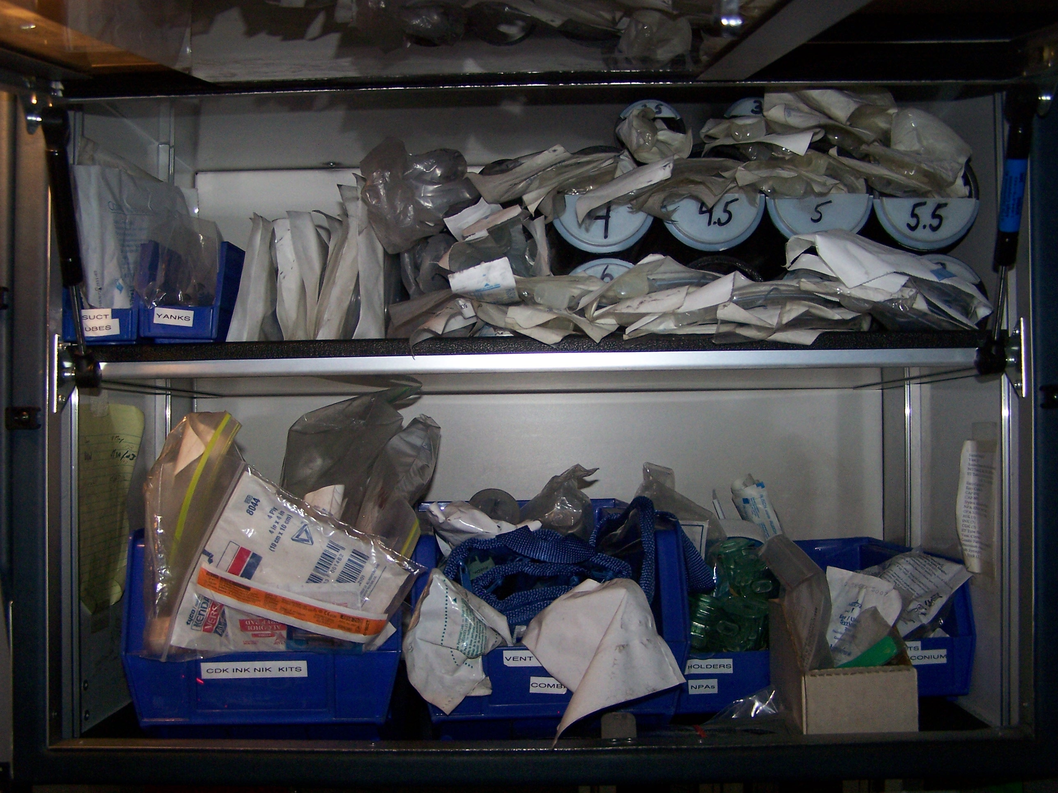
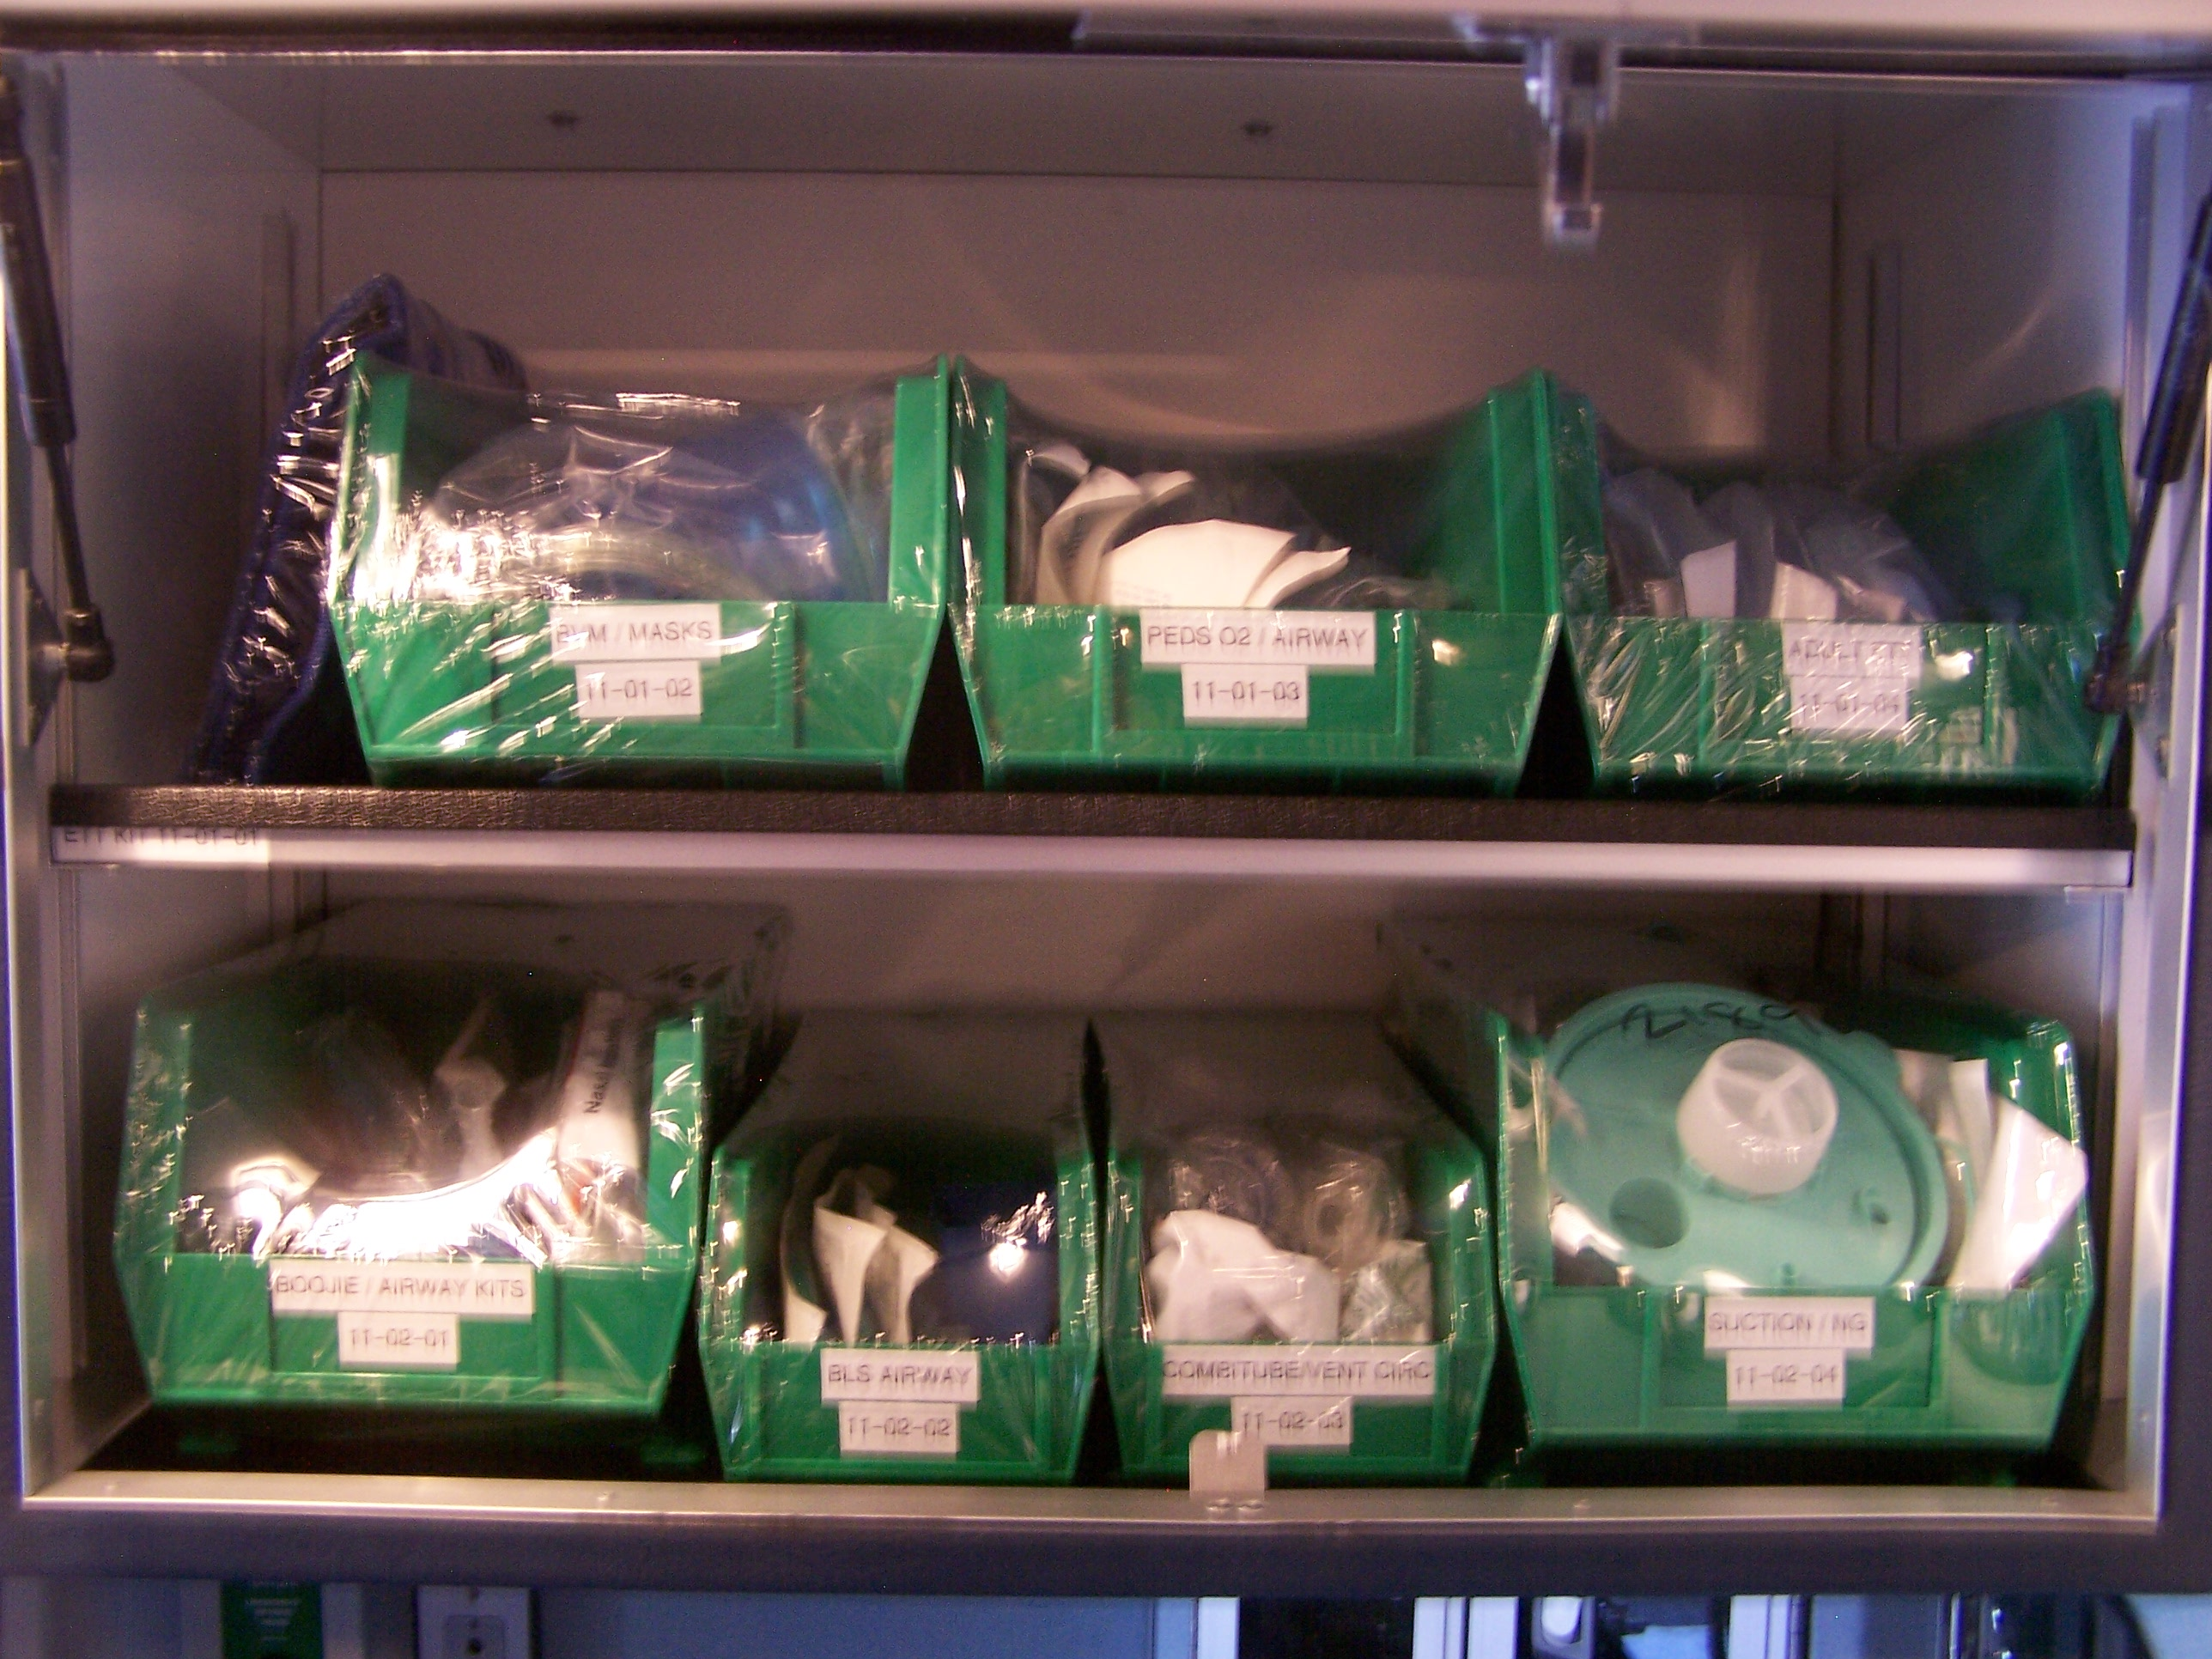
Vehicle Cleanliness and Organization
Before
After

Slide 31
Key Performance Indicators
HPEMS Example
Vehicle Cleanliness and Organization
  Operational KPIs
    SOS/EOS evaluation rank score
    Service Point / Speed Loader audit quality quotient
    Internal peer survey results
    Recognition program quantities
  Qualitative KPIs
    Customer satisfaction quotient on vehicles
    Number of complaints regarding vehicle issues
    Number of complements regarding vehicle issues
  Financial
    Vehicle cleaning costs
    Supply costs

Slide 32
Key Performance Indicators
HPEMS Example
Vehicle Comfort and Ride
  Operational KPIs
    Patient and peer based vehicle ride quality quotient
    Fleet maintenance record monitoring on suspension
    Road safety scores
  Qualitative KPIs
    Customer satisfaction quotient on ride comfort
    Number of complaints regarding vehicle ride comfort
    Number of complements regarding vehicle ride comfort
  Financial
    Vehicle suspension maintenance costs
    Stretcher maintenance costs

Slide 33
Key Performance Indicators
HPEMS Example
Clinical Sophistication and Outcomes
  Operational KPIs
    ePCR documentation compliance to protocol with feedback loop scores
    Number of employees trained on new tool/procedure
    Test scores on new tool/procedure
    Psychomotor success rates
    Capture rates of outcome data requirements

Slide 34
Key Performance Indicators
HPEMS Example
Clinical Sophistication and Outcomes Continued…
  Qualitative KPIs
    Customer satisfaction quotient on clinical measurements
    Effectiveness of new tool/procedure on morbidity/mortality/outcome
    Outcomes based improvement quotient
  Financial
    Capital spent on new equipment
    Number of medical malpractice lawsuits

Slide 35
Trending KPIs
Definition
Importance
Types
Examples

Slide 36
Trending KPIs
Definition
Trend
“A general direction in which something is developing or changing”
Source: Oxford American Dictionary

Slide 37
Trending KPIs
Importance of Trending
Visual representation of data
Without graphical trending, you are just looking at a bunch of indistinguishable numbers
Enables ability to see direction of the variable being measured (up or down – good or bad)
Provides situational awareness of special cause variation (i.e. see the train coming BEFORE it hits you)

Slide 38
Trending KPIs
Common HPEMS Trending Types
  Run Chart
    Data displayed in time sequence
    May include trending lines
    Provides visualization of shifts in output
  SPC: Statistical Process Control Chart
    Taken from manufacturing
    Enables identification of Special Cause Variations
    Used to determine if a business process is in a state of control

Slide 39
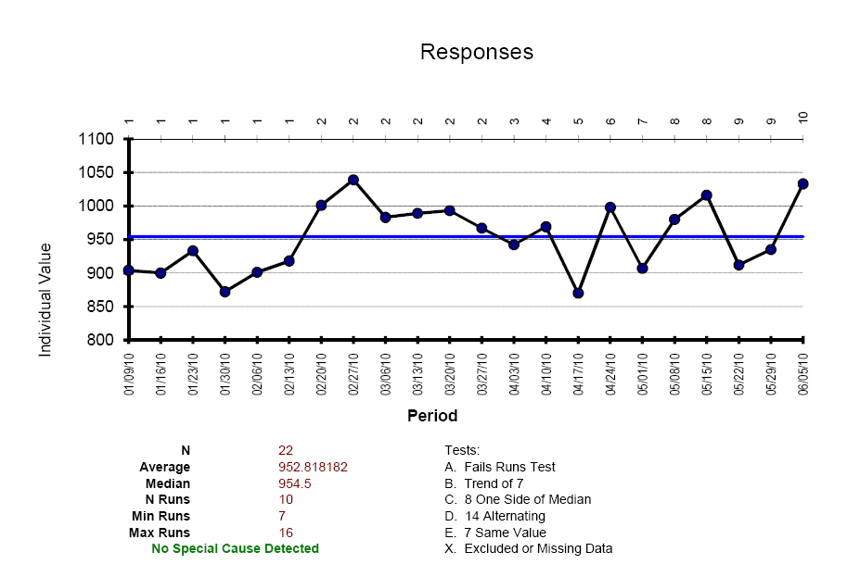
Run Chart Example

Slide 40
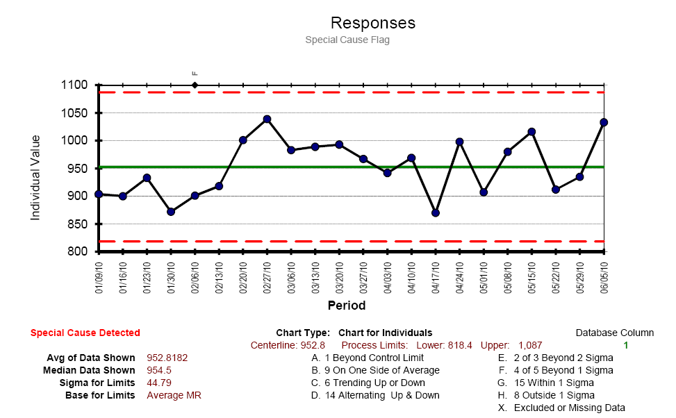
Control Chart Example

Slide 41

Benchmarking KPIs
Definition
Importance
Types
Examples
Notes:
Not talking about this kind of benchmarking

Slide 42
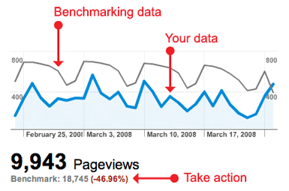
This kind of Benchmarking

Slide 43
Benchmarking KPIs
Definition
“Benchmarking is the process of comparing one's business processes and performance metrics to industry bests and/or best practices from other industries. Dimensions typically measured are quality, time, and cost. Improvements from learning mean doing things better, faster, and cheaper.”
Source: Wikipedia

Slide 44
Benchmarking KPIs
Importance of Benchmarking
Enlightenment from unconsciously incompetent to master of a domain (it tells you if you suck or you rock)
“Gut Check / Check Sum” via validation
Sets the stage for “industry standards”
Provides defensive footholds when under fire (protection of service areas)
Shows if a process change made a difference
Shows opportunities for improvement
Option for ensuring System Accountability vs. Going out to Bid every 5 – 7 years

Slide 45
Benchmarking KPIs
Types of Benchmarking
Internal (Very Easy)
  Measure one’s self against one’s self
  Comparison of trend data before a process change and after a process change to see the impact
External (has been VERY challenging for EMS)
  Measure one’s self against someone else
  Comparison of identically defined measurements tools (KPI) that also have common process / variable denominators

Slide 46
Benchmarking KPIs
External Benchmarking
Challenges
  EMS Darwinism (come back to this)
  Lack of Common Vernacular
  No EMS standards body (like NFPA)
  Varied definitions of variables and measurements
  Common denominator variables mostly possible
    EMS Deployment Challenging
    Ops, Billing, Comm, Fleet, QI, HR, Training, SRM, Logistics all have common themes available

Slide 47
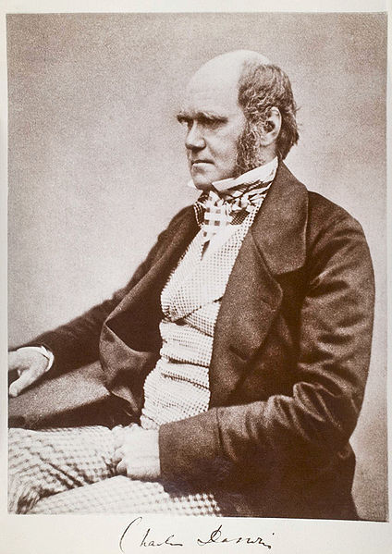
The Theory of EMS Darwinism
Darwinism / Evolutionary Theory
  Isolated environments produce similar species that evolve in different ways from each other
  Evolutionary adaptation to the environment occurs to ensure survival of the species
  EMS has “evolved” under these principles

Slide 48
The Theory of EMS Darwinism
EMS agencies are isolated from each other due to proprietary barriers created by varying system designs, ownership models and funding sources
Gives credence to the phrase “If you’ve seen one EMS system, you’ve seen one EMS system”
However, they are still of the same species…
Common operational denominators exist for every EMS system which provide the foundation for “Best Practices”
Acceptance of these “Best Practices” depends on your system design, necessity for change, culture and other factors

Slide 49
The Theory of EMS Darwinism

Slide 50
My industry experience has been…
Necessity may be the mother invention however…
…it also drives acceptance of the previously unacceptable

Slide 51
Current / Future Economic and Demographic Conditions
If there ever has been a time where necessity will drive innovation, acceptance of the unacceptable and the merging of separately evolved species into one, it is now!
Shrinking public funding mechanisms, uncertain healthcare dollars and rising unemployment in the face of a large aging boomer generation will force industry innovation and change
Funding / service level / employment compensation tradeoff’s or service delivery model design changes…you decide (as may the current presidential administration)

Slide 52
Benchmarking KPIs
How do we fix this problem…
  Develop industry governed common standards body / organization
    Set Vernacular
    Set Variables / Definitions
    Set Measurements
    Develop Comparison Tools
  EMS agencies MUST adopt and support these standards in their operations
  CAAS or AAA possible existing bodies that could accomplish this
  Healthcare reform may change this for us since we can’t seem to do it for ourselves

Slide 53

Leveraging Technology
Technology is your friend
OTS vs. Custom
Dashboards - Scorecards
Situational Awareness Systems

Slide 54
Leveraging Technology
Technology is your friend
  EMS needs to embrace technology
  Cloud based systems making affordability of new technologies and replacement of legacy systems reachable
  Hire staff / implement strategies that leverage technology for greater efficiencies and effectiveness
  Leverage your vendors!
  Don’t be penny wise and pound foolish
  New business models (SAAS) are GOOD NOT BAD!

Slide 55
Leveraging Technology
Why Traditional Software Business Models often Fail in EMS
  Large upfront sales price
  Support based on % of initial sales price (18%-20%)
  Works well until market cap reached
  As new sales revenues drop, support fees can’t maintain infrastructure
  Shift to lateral or vertical markets to survive
  Abandonment of original customer base to pursue emerging markets typical
  Customer service tanks
  EMS isn’t as wealthy as the lay business community assumes

Slide 56
Leveraging Technology
Why EMS Should Embrace Software As A Service (SAAS) Business Models
  Hosted infrastructure based model
  Lower long-term costs
  Monthly fees or cost per call based
  Recurring revenues = solid business base that can continuously support itself even when market cap is reached
  No survival needs to shift to other market focus
  Customer service can be maintained / improved
  Hosting technologies and internet connectivity becoming highly reliable, redundant and secure

Slide 57
Leveraging Technology
Emerging Leading Edge SAAS Technologies
  Situational Awareness Systems / CAD Supplements
    GPS/AVL
    MDT / Mapping
    Online CAD Views
  ePCR / Billing
  Operational Surveillance / Reporting Systems
    Dashboards
  CAD
    Yes CAD…..it’s coming!

Slide 58
Leveraging Technology
OTS (Off the Shelf) KPI & Trending Solutions
  FirstWatch (www.firstwatch.net)
  Xcelsius (www.sap.com)
  QI Macros (www.qimacros.com)
  BPChart400.XLS (3M Product)
  Microsoft Office Live (www.officelive.com)
    Share Point Server

Slide 59
Leveraging Technology
Custom Solutions
  Some of the most successful companies have figured out that it’s best to develop in-house, custom software that meet their optimized business processes
  Creates proprietary solutions that differentiate
  Examples
    Our Industry: AirMethods, HSI, Sansio, Toronto EMS, REMSA
    Other Industry: FedEx, UPS, Apple
  Controlling hardware and software is the real secret if you can afford it

Slide 60
Leveraging Technology
Dashboards – Scorecards
  One consolidated place to monitor KPI’s
  Typically Grouped / Tabbed by Strategic Goals
  Usually gauge like in design for easy interpretation
  Show goal and current situation since last measured
  Timeliness of dashboard must be considered
    Best are real-time
    Most include some sort of latency

Slide 61
FirstWatch “Performance Plus”

Slide 62
Leveraging Technology
Situational Awareness Systems
  Goal: Merge data from Dashboard / KPI technologies with other data feeds that are difficult or impossible to quantify as a number
  Human intelligence
    Operational data
    Shift Reports
    Running Task Lists
    QI Systems / Feedback Loop Closure Systems
    Weather Outlook
    Production Schedule
    After Action Review (AAR) data / notes
    Flight Data (PFS)
  SharePoint Server / Office Live for Small Business

Slide 63

Achieving HPEMS

Slide 64
Achieving HPEMS
It’s not a destination…
…it’s a lifestyle
if you are doing it right

Slide 65
Achieving HPEMS
You known you are there when…
You understand the inter-relationships between processes within your organization especially between departments
Every process within your organization has been re-engineered to maximize efficiency and effectiveness
You are measuring, trending and benchmarking KPIs
Your processes are no longer siloed
The entire organization is focused on quality, effectiveness and efficiency

Slide 66
Achieving HPEMS
You know you are there when…
You have maximized service from available dollars in a reasonable and balanced fashion:
  Patient Care
  Employee Wellbeing
  Financial Success
Management team is proactive versus reactive
Culture where processes consistently learn from their mistakes and improve
KPI’s are a guide for the journey, not the end-all-be-all (don’t be the idiot that followed their GPS into the desert and then died)
  Treat the patient not the monitor

Slide 67
Questions?
Thank You for Your Time Today…
www.washkoassoc.com
www.remsa-cf.com
jw@washkoassoc.com / 775-453-4776
Copies of this presentation will be available for download at
http://washkoassoc.com/downloads.aspx

