Slide 1
All ALS vs. Tiered EMS System Design
An Operational Perspective

Slide 2
Topics Covered
History
Delivery Models
Staffing Models
EMS System Design – Clinical vs. Economic
Operational Impacts
Cost Impacts
Controversies
Conclusions

Slide 3
Introduction
Dave Shrader
The Polaris Group
Jonathan Washko, BS-EMSA, NREMT-P, EMD
AVP NS-LIJ Center for EMS
Washko & Associates, LLC

Slide 4
Presentation Background
Controversies in EMS Design – All ALS vs. Tiered, a Scientific Review
Well put together presentation with scary clinical results for the industry
Clearly demonstrates the need to develop and maintain ALS skills
Need to further clarify cause and effect of results
Training deficits
Experience deficits
Task time elements
First responder elements
“If you have seen one EMS system you’ve seen one EMS system” as no two are alike

Slide 5
Presentation Background
Each EMS System has to make most of resources available to it
Money
People
Public Expectations (In and Out)
Clinical Resources
We agree that we should challenge and investigate the value and appropriateness of ALS as a whole, and the cost/benefit of each procedure
So busy trying to prove that we could, we never stopped to ask the questions if we should?
So busy trying to do things right that we forgot to ask if we were doing the right things?

Slide 6
History & Evolution of All ALS in the U.S.
Citizen Expectations
Clinical Beginnings
Reimbursement
Professional Advancement / Incremental Pay
Operational / Economic Efficiencies (Stout / Overton)
Clinical Specializations (CCEMTP, EMTP, EMTI, EMT-B)
Clinical Research
Public Safety vs. Healthcare Identity Crisis
Advance Practice / Healthcare Integration of EMS

Slide 7
Delivery Model Types
BLS Transport Only
BLS Transport with ALS Fly Car
BLS Transport with ALS Fire First Response
ALS Transport with BLS Fire First Response
ALS Transport with ILS Fire First Response
ALS Transport with ALS Fire First Response
ALS & BLS Transport with BLS Fire First Response (Tiered)

Slide 8
Staffing Models
EMT-B + EMT-B
EMT-B + EMT-I
EMT-B + EMT-P
EMT-I + EMT-P
EMT-P + EMT-P
EMT-B + EMT-P + EMT-P
EMT-P + EMT-P + EMT-P
EMT-B + EMT-B + MICN (RN)
EMT-B + EMT-P + MICN (RN)
EMT-B + CCEMTP
EMT-B + CCEMTP + MICN (RN)
EMT-B + MICN + PA
EMT-B + MICN + Respiratory Therapist / Perfusionist
EMT-P + RN + Board Certified MD (Cardiologist, Internist, Emergency)
Others

Slide 9
EMS System Design Clinical vs. Economic
Factors that drive design
Response Time Goals
Clinical significance (small percentage)
Customer service / expectations
Time sensitivity of “critical” calls
Geography vs. Geotemporal Demand
Economics
Politics
Specialized vs. flexible deployment
Tiered Response Model
Fixed vs. dynamic
Overlapping coverage networks
Risk tolerance vs economic sustainability
Scalable risk

Slide 10
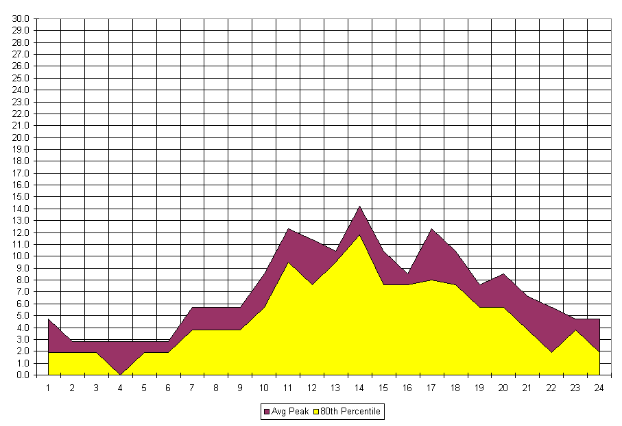
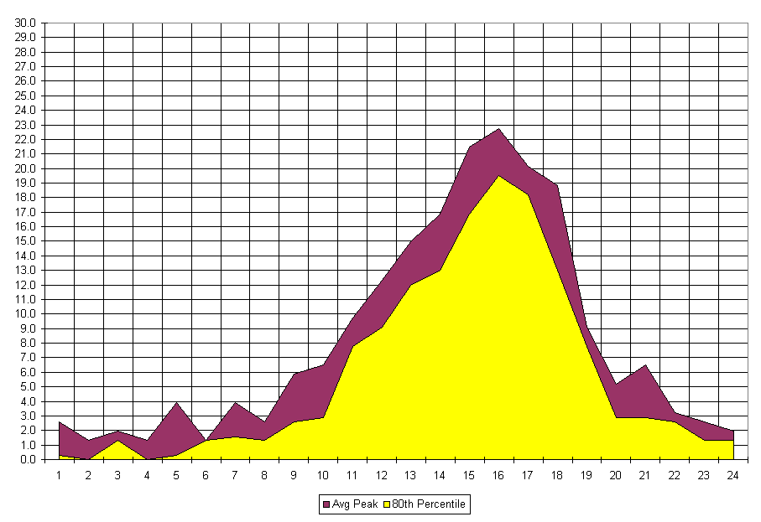
Strategic Deployment Plan Controls Overview
The Synergistic Effects of a Mixed Deployment Strategy
ALS Demand
BLS Demand
+
172.9 UH @ 90%
197 UH @ 90%
ALS + BLS @ 90% Coverage = 369.9 UH

Slide 11
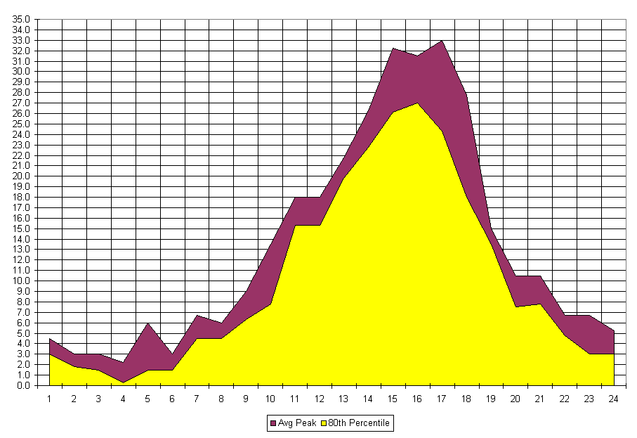
Strategic Deployment Plan Controls Overview
The Synergistic Effects of a Mixed Deployment Strategy
System Demand @ 90%
System @ 90% Coverage = 320.3 UH

Slide 12
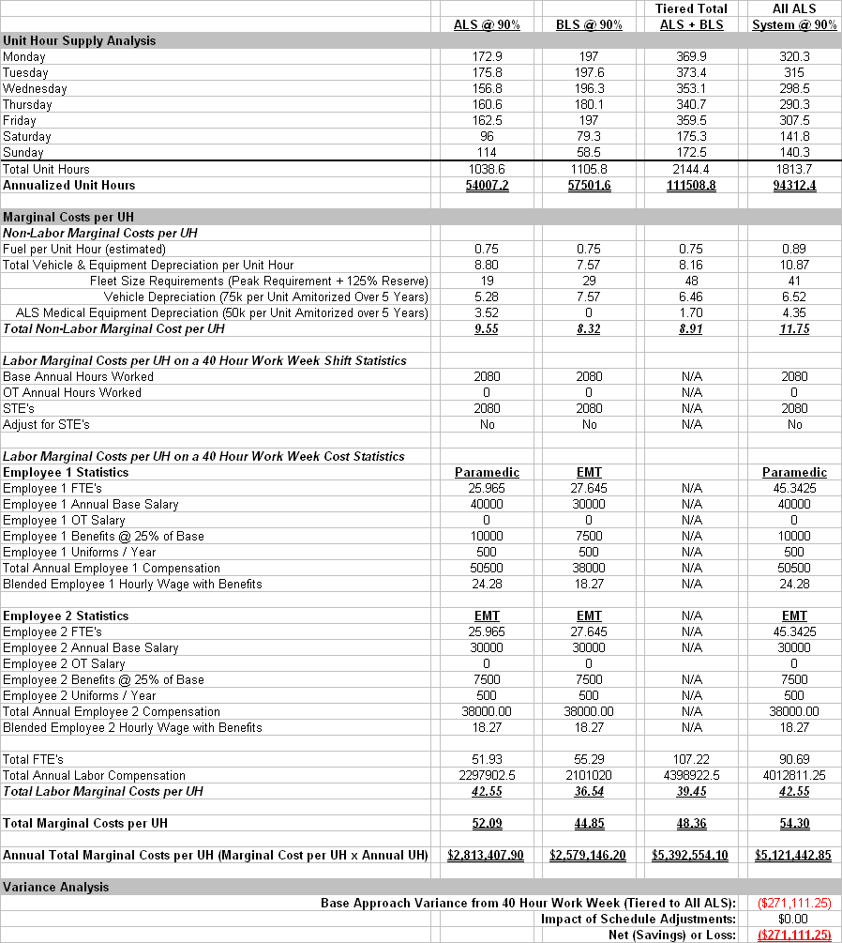
The Synergistic Impacts of Tiered vs. Flexible Deployment Model Approaches

Slide 13
Operational Impacts
Triage and sorting reliability (un)
Cost of service per patient
Productivity vs. unit hours costs
Operational flexibility (standardization)
Equipment, Fleet, Dispatch Methods
Compounding complexities of production
Payroll costs and OT
Specialized skills (Square Peg – Round Hole)
Mismatch of services

Slide 14
Cost Impacts
Economies of scale
Utility economics
Loss of revenues (BLS vs ALS reimbursement)
More for the same $$$
Do same for less $$$
Overton, J. ALS and BLS A Cost Effectiveness Study. Presentation – NAEMSP, January 2000

Slide 15
Controversies
System overload situations
Clinical concerns
Employee well-being concerns
Experience in U.S. of Elitist attitudes of Paramedics in tiered systems that can impede quality patient care
Cause / Effect???
Mismatching of services

Slide 16
Conclusions
All variables must be assessed in determining system design
Clinical, economic, operational, political, employee
One size does not fit all
Further clinical, operational and financial research is needed before we throw the baby out with the bath water
Is ALS needed at all or do we need ILS or do our Paramedics need to do less skills
Single tier is financially preferable model that achieves same/better performance at lower cost
Use $$$ to improve clinical sophistication

Slide 17
Conclusions Continued…
Underlying cause of poor ALS performance is insufficient training and experience
To solve problem we should address at root of problem
Clinical experiences (simulation, regionalization, collaboration)
Clinical credentialing
Operational / process improvement

Slide 18
Contact Us
Dave Shrader
dshrader@thepolarisgroup.org
Jonathan Washko
jwashko@washkoassoc.com
jwashko@nshs.edu

